Slide 1

2021 ANNUAL GENERAL
MEMBERSHIP MEETING
Nominees for the AFPMBAI Board of Trustees

Slide 2

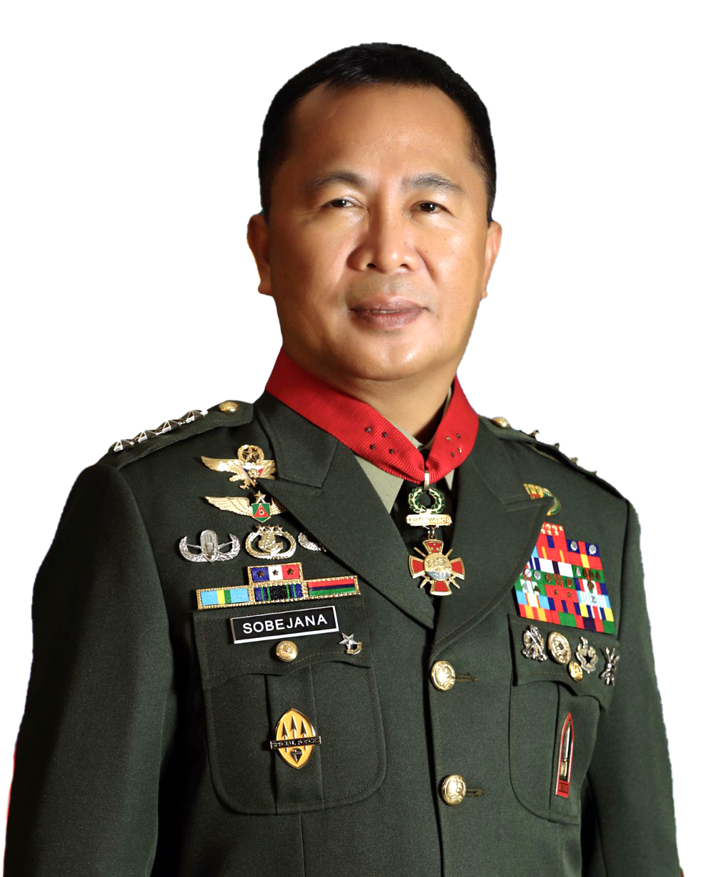
Nominee for the AFPMBAI Board of Trustees
Representative from the Office of the AFP Chief of Staff | Gen Cirilito E Sobejana PA
Age | 55 years old
Date of First Election | Mar 5, 2021
Relevant Academic Background and Training/Experience
Graduate School | Philippine Christian University
Degree/Course | Master in Public Administration
Completed | March 15, 2008
Graduate School | Ateneo de Manila University
Degree/Course | Master in Business Administration (Not Completed)
Relevant Training | Briefing on AFPMBAI Operations
Inclusive Date | January 26, 2021
Course | Course on Corporate Governance
Completed | June 22, 2012
Course | Managing the Supply Chain
Completed | November 26, 2001
2021 ANNUAL GENERAL MEMBERSHIP MEETING

Slide 3
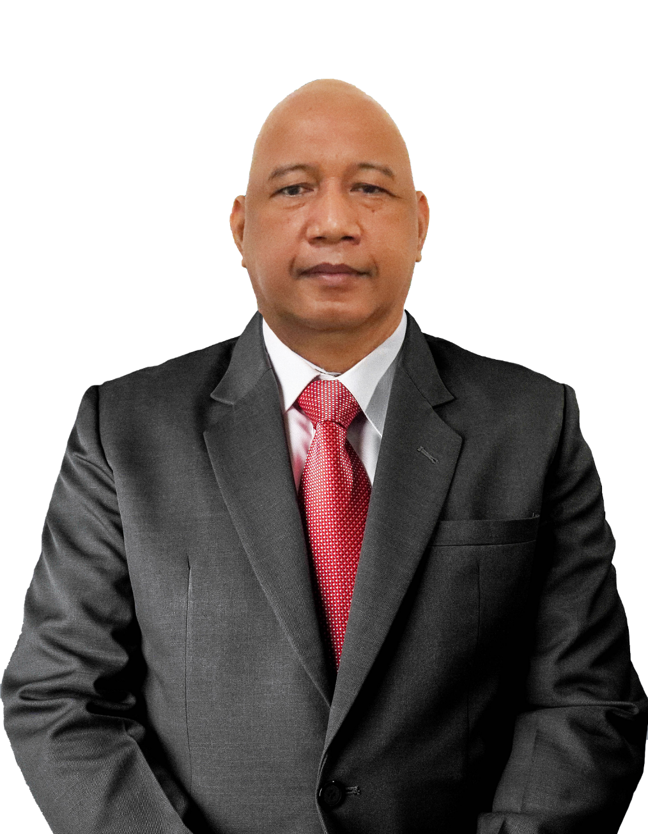
Nominee for the AFPMBAI Board of Trustees
Joint Staff of the AFP | MGen Adriano S Perez Jr PA
Age | 54 years old
Date of First Election | July 11, 2020
Relevant Academic Background and Training/Experience
Graduate School | Philippine Christian University
Degree/Course | Masters in Management
Completed | September 18, 2007
Relevant Training | Briefing on AFPMBAI Operations
Completed | 2020
Relevant Training | Continuing Education Program
Topics/Inclusive Dates | Business Model Shift: Pivoting Toward a New and Better Normal (August 26, 2020 Part I)
 | Strategic Thinking (August 28, 2020 Part II)
 | Latest Developments in the Mutual Benefit Association and Insurance Industry (September 24, 2020 Part III)
 | AMLA Webinar conducted by the Insurance Commission (October 14, 2020 Part IV)
Relevant Training | Professional Directors Program (ICD)
Inclusive Dates | June 24, 2016
Relevant Training | Corporate Governance Orientation Program
Inclusive Dates | 2016
2021 ANNUAL GENERAL MEMBERSHIP MEETING

Slide 4
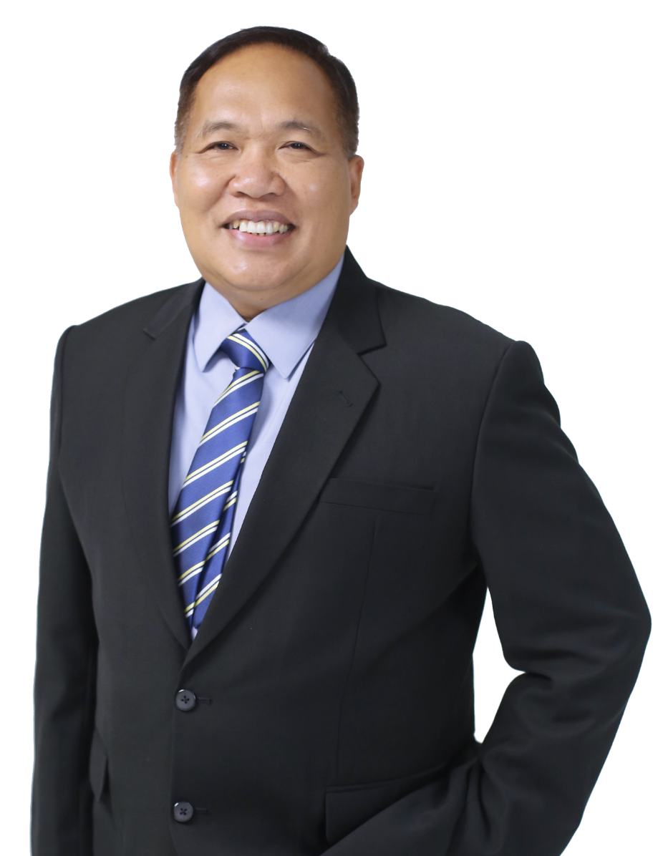
Nominee for the AFPMBAI Board of Trustees
At Large | MGen Rizaldo B Limoso PA (Ret)
Age | 57 years old
Date of First Election | July 11, 2020
Relevant Academic Background and Training/Experience
Graduate School | University of Melbourne
Degree/Course | Masters of Applied Science
Completed | 2002
Graduate School | Ateneo De Manila University
Degree/Course | Masters in Business Administration
Completed | 1996
Relevant Training | Continuing Education Program
Topics/Inclusive Dates | Business Model Shift: Pivoting Toward a New and Better Normal (August 26, 2020 Part I)
 | Strategic Thinking (August 28, 2020 Part II)
 | Latest Developments in the Mutual Benefit Association and Insurance Industry (September 24, 2020 Part III)
 | AMLA Webinar conducted by the Insurance Commission (October 14, 2020 Part IV)
Relevant Training | Corporate Governance Orientation Program
Inclusive Dates | 2012
Relevant Training | Professional Directors Program (ICD)
Inclusive Dates | 2012
2021 ANNUAL GENERAL MEMBERSHIP MEETING

Slide 5
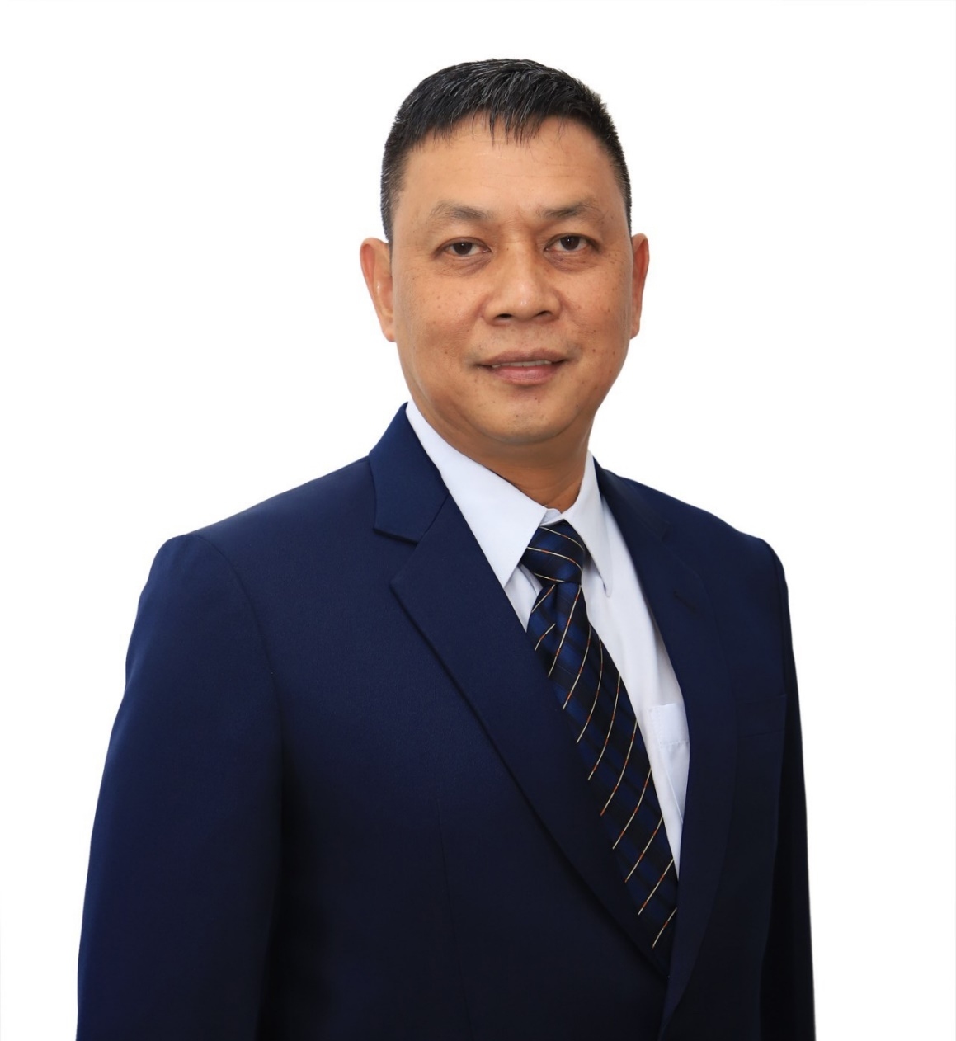
Nominee for the AFPMBAI Board of Trustees
PA Representative | MGen Robert C Dauz PA
Age | 54 years old
Date of First Election | December 23, 2020
Relevant Academic Background and Training/Experience
Course | Strategic HRM for the PA
Completed | July 8, 2017
Relevant Training | Corporate Governance Orientation Program
Completed | March 3 & 4, 2021
Relevant Training | Briefing on AFPMBAI Operations
Inclusive Dates | February 2, 2021
Course | Seminar on Financial Statement Analysis
Completed | January 31, 2001
Course | Strategic Human Resource Management for the PA
Completed | March 8, 2001
2021 ANNUAL GENERAL MEMBERSHIP MEETING

Slide 6
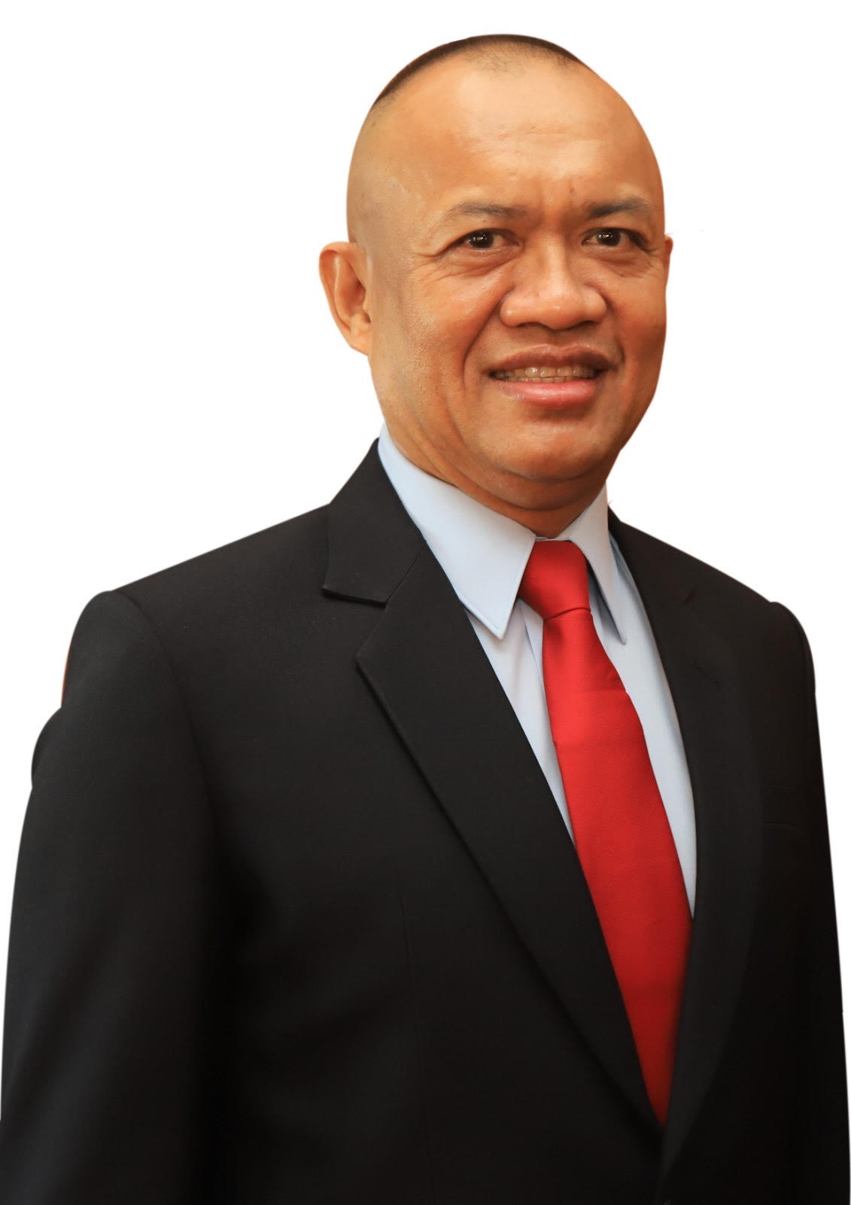
Nominee for the AFPMBAI Board of Trustees
PN Representative | RAdm Adeluis S Bordado PN
Age | 54 years old
Date of First Election | Feb 1, 2021
Relevant Academic Background and Training/Experience
Course | Corporate Governance Orientation Program
Completed | March 3 & 4, 2021
Relevant Training | Briefing on AFPMBAI Operations
Inclusive date | February 15, 2021
Course | Business Economics
Completed | 2004
2021 ANNUAL GENERAL MEMBERSHIP MEETING

Slide 7
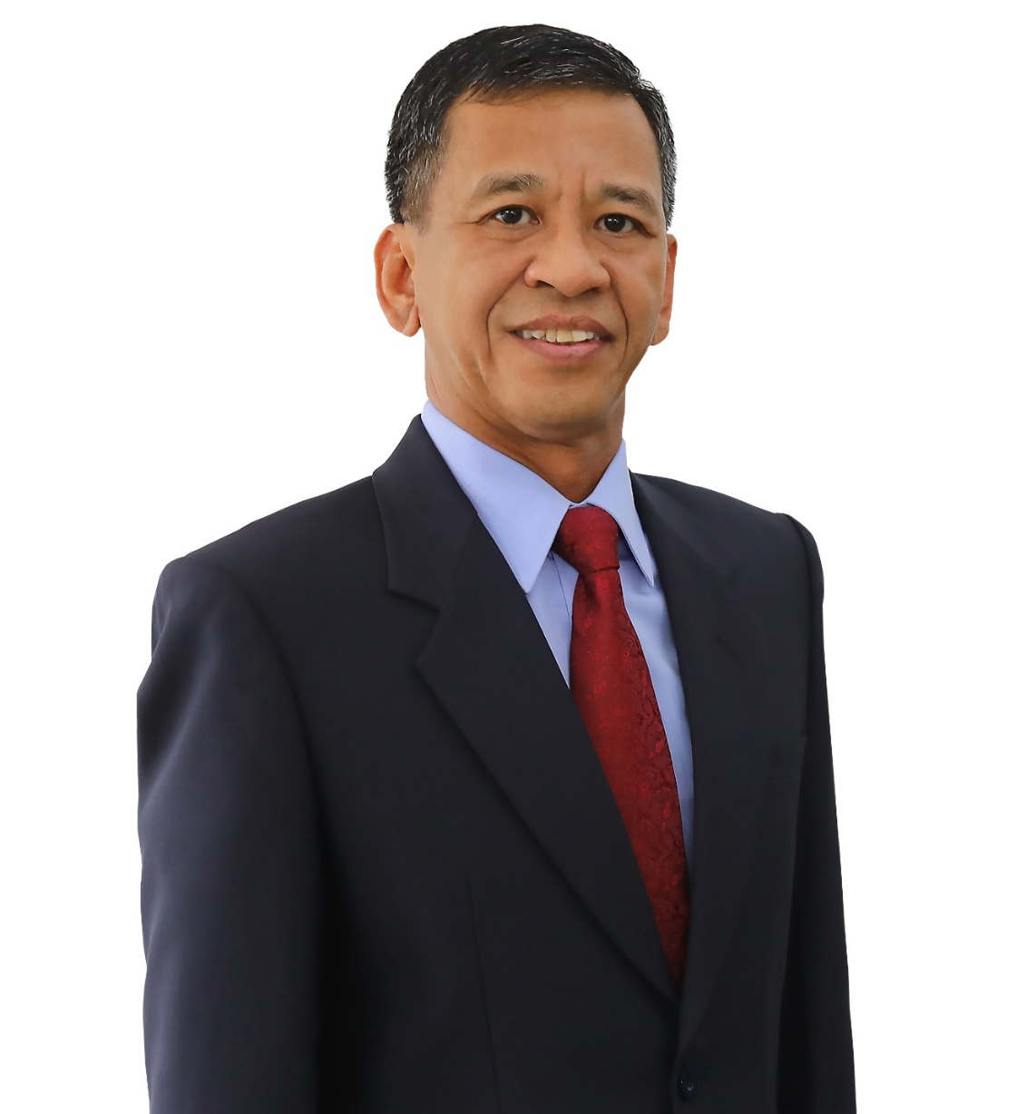
Nominee for the AFPMBAI Board of Trustees
PAF Representative | MGen Florante M Amano PAF
Age | 54 years old
Date of First Election | May 15, 2021
Relevant Academic Background and Training/Experience
Graduate School | University of the Philippines
Degree/Course | Master in Public Management
Completed | 31 March 2002
Relevant Training | AFP Comptroller Basic Course
Inclusive date | 25 April 2003
Relevant Training | Orientation Course on Corporate Governance
Inclusive date | 12 -13 April 2013
2021 ANNUAL GENERAL MEMBERSHIP MEETING

Slide 8
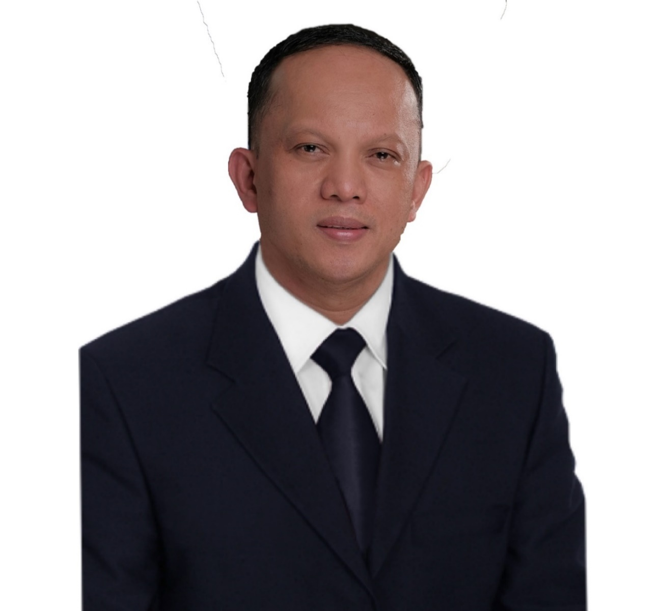
Nominee for the AFPMBAI Board of Trustees
PNP Representative | PMGen Rhoderick C Armamento
Age | 52 years old
Date First Elected | May 15, 2021
Relevant Academic Background and Training/Experience
Graduate School | Araullo University
Degree/Course | Master of Arts
Completed | 2005
College | PNPA
Course | BS Public Safety
Completed | 1990
College | Manuel S. Enverga University Foundation
Course | AB Political Science
Completed | 1987
Relevant Training | Finance Officers Basic Course
Completed | 30 September 1993
2021 ANNUAL GENERAL MEMBERSHIP MEETING

Slide 9
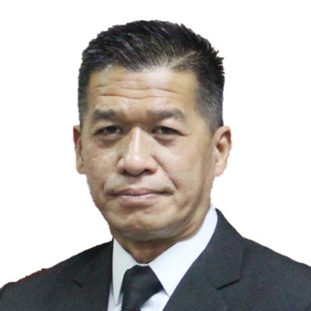
Nominee for the AFPMBAI Board of Trustees
PNP Representative | PBGen Arthur V Bisnar
Age | 52 years old
Date of First Election | May 15, 2021
Relevant Academic Background and Training/Experience
Graduate School | Philippine Christian University
Degree/Course | Master in Management
Completed | 2014
Graduate School | Ateneo
Degree/Course | BS Computer Science
Inclusive Dates | 2002-2003
Relevant Training | ADH Houston Community College
Completed | 2003-2006
Relevant Training | Courses at the Ateneo Law School
Completed | 1995
Relevant Training | Seminar on Anti-Money Laundering
Completed | November 11, 2016
Relevant Training | Investigative Information Management Course
Completed | September 26, 2014
2021 ANNUAL GENERAL MEMBERSHIP MEETING

Slide 10
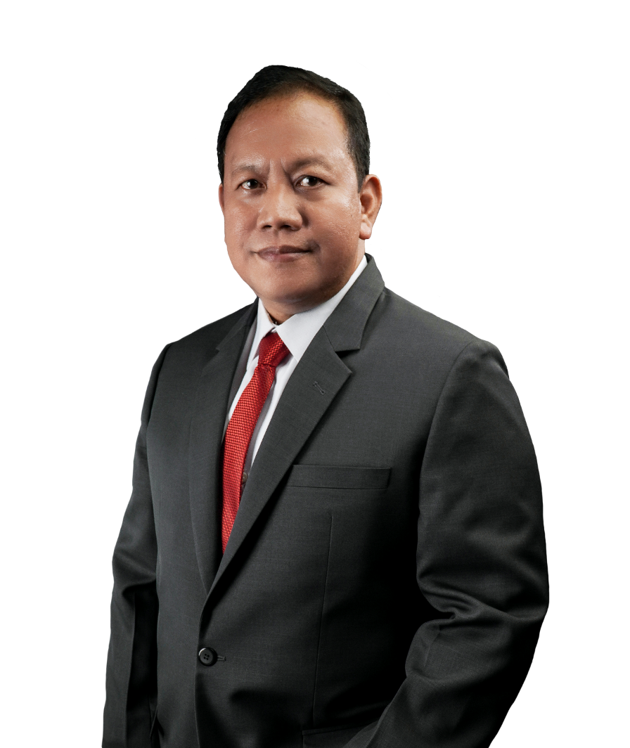
Nominee for the AFPMBAI Board of Trustees
PCG Representative | VAdm Leopoldo V Laroya PCG
Age | 54 years old
Date of First Election | September 27, 2019
Relevant Academic Background and Training/Experience
Course | Strategic Thinking in Times of Pandemic
Completed | April 2020
Relevant Training | Briefing on AFPMBAI Operations
Completed | 2019
Relevant Training | Continuing Education Program
Topics/Inclusive Dates | Business Model Shift: Pivoting Toward a New and Better Normal (August 26, 2020 Part I)
 | Strategic Thinking (August 28, 2020 Part II)
 | Latest Developments in the Mutual Benefit Association and Insurance Industry (September 24, 2020 Part III)
Relevant Training | Corporate Governance Orientation Program
Completed | October 30, 2019
2021 ANNUAL GENERAL MEMBERSHIP MEETING

Slide 11
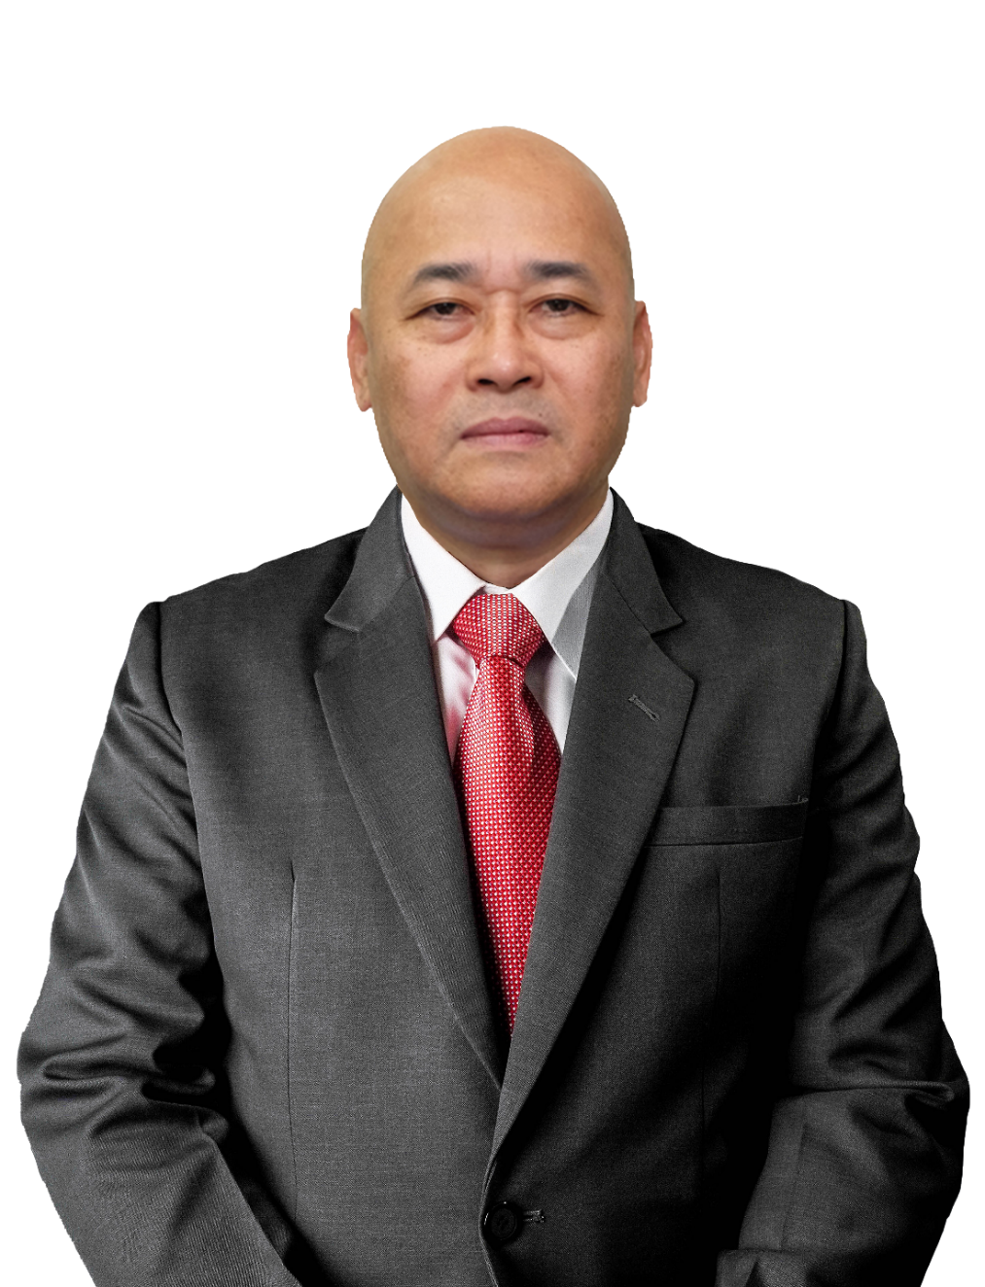
Nominee for the AFPMBAI Board of Trustees
BFP Representative | CSupt Roel Jeremy G Diaz BFP
Age | 54 years old
Date of First Election | June 10, 2020
Relevant Academic Background and Training/Experience
Graduate School | University of Iloilo
Degree/Course | Master in Public Administration
Completed | 2002
Law School | University of Iloilo
Degree/Course | Bachelor of Laws (LLB)
Completed | 2000
Relevant Training | Briefing on AFPMBAI Operations
Completed | 2020
Relevant Training | Continuing Education Program
Topics/Inclusive Dates | Business Model Shift: Pivoting Toward a New and Better Normal (August 26, 2020 Part I)
 | Strategic Thinking (August 28, 2020 Part II)
 | Latest Developments in the Mutual Benefit Association and Insurance Industry (September 24, 2020 Part III)
Relevant Training | Course on Basic Policy Process (DAP)
Completed | March 2016
Course | Corporate Governance Orientation Program
Completed | March 3 & 4, 2021
2021 ANNUAL GENERAL MEMBERSHIP MEETING

Slide 12
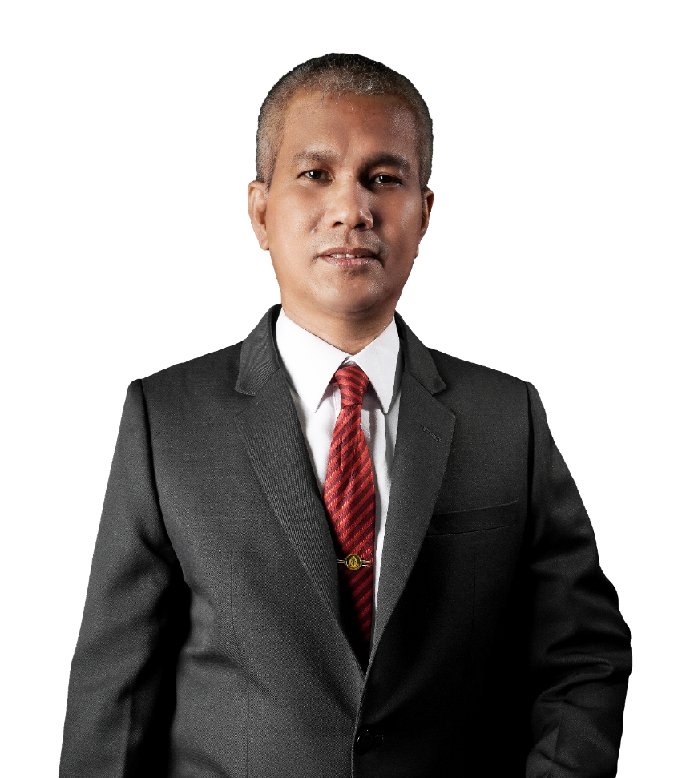
Nominee for the AFPMBAI Board of Trustees
BJMP Representative | J/CSupt Ruel S Rivera
Age | 50 years old
Date of First Election | May 18, 2019
Relevant Academic Background and Training/Experience
Graduate School | Batangas State University
Degree/Course | Master in Public Administration
Completed | 1999
Relevant Training | Continuing Education Program
Topics/Inclusive Dates | Business Model Shift: Pivoting Toward a New and Better Normal (August 26, 2020 Part I)
 | Strategic Thinking (August 28, 2020 Part II)
 | Latest Developments in the Mutual Benefit Association and Insurance Industry (September 24, 2020 Part III)
 | AMLA Webinar by IC (October 14, 2020 Part IV)
Relevant Training | Briefing on AFPMBAI Operations
Completed | 2019
Relevant Training | Corporate Governance Orientation Program
Completed | August 2019
Relevant Training | Exec Course on Money Laundering and Terrorism Financing
Completed | March 3, 2012
Relevant Training | Seminar on Financial Resources, Ethics and Accountability
Completed | April 9, 1994
2021 ANNUAL GENERAL MEMBERSHIP MEETING

Slide 13
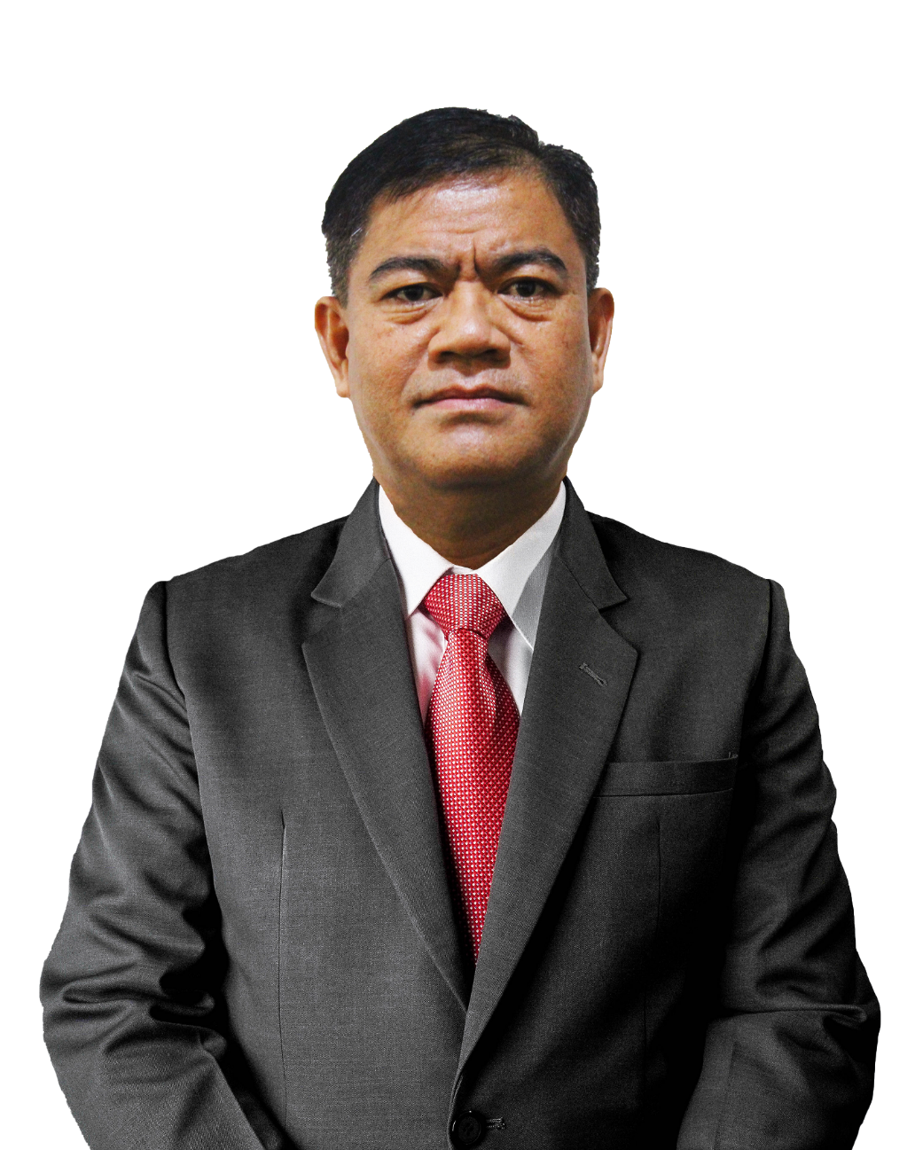
Nominee for the AFPMBAI Board of Trustees
Representative from the Office of the AFP Sergeant Major | FCMS Aladin S Dacayanan (INF) PA
Age | 54 years old
Date of First Election | August 27, 2020
Relevant Academic Background and Training/Experience
Relevant Training | Briefing on AFPMBAI Operations
Completed | 2020
Relevant Training | Continuing Education Program
Topics/Inclusive Dates | Latest Developments in the Mutual Benefit Association and Insurance Industry (September 24, 2020 Part III)
 | AMLA Webinar by IC (October 14, 2020 Part IV)
Relevant Training | Corporate Governance Orientation Program
Completed | September 2020
Relevant Experience | Director, Kitanglad Multipurpose Cooperative
Period | 2017- to date
Relevant Experience | Chairman, Kitanglad Multipurpose Cooperative
Period | 2017 and 2019
2021 ANNUAL GENERAL MEMBERSHIP MEETING

Slide 14
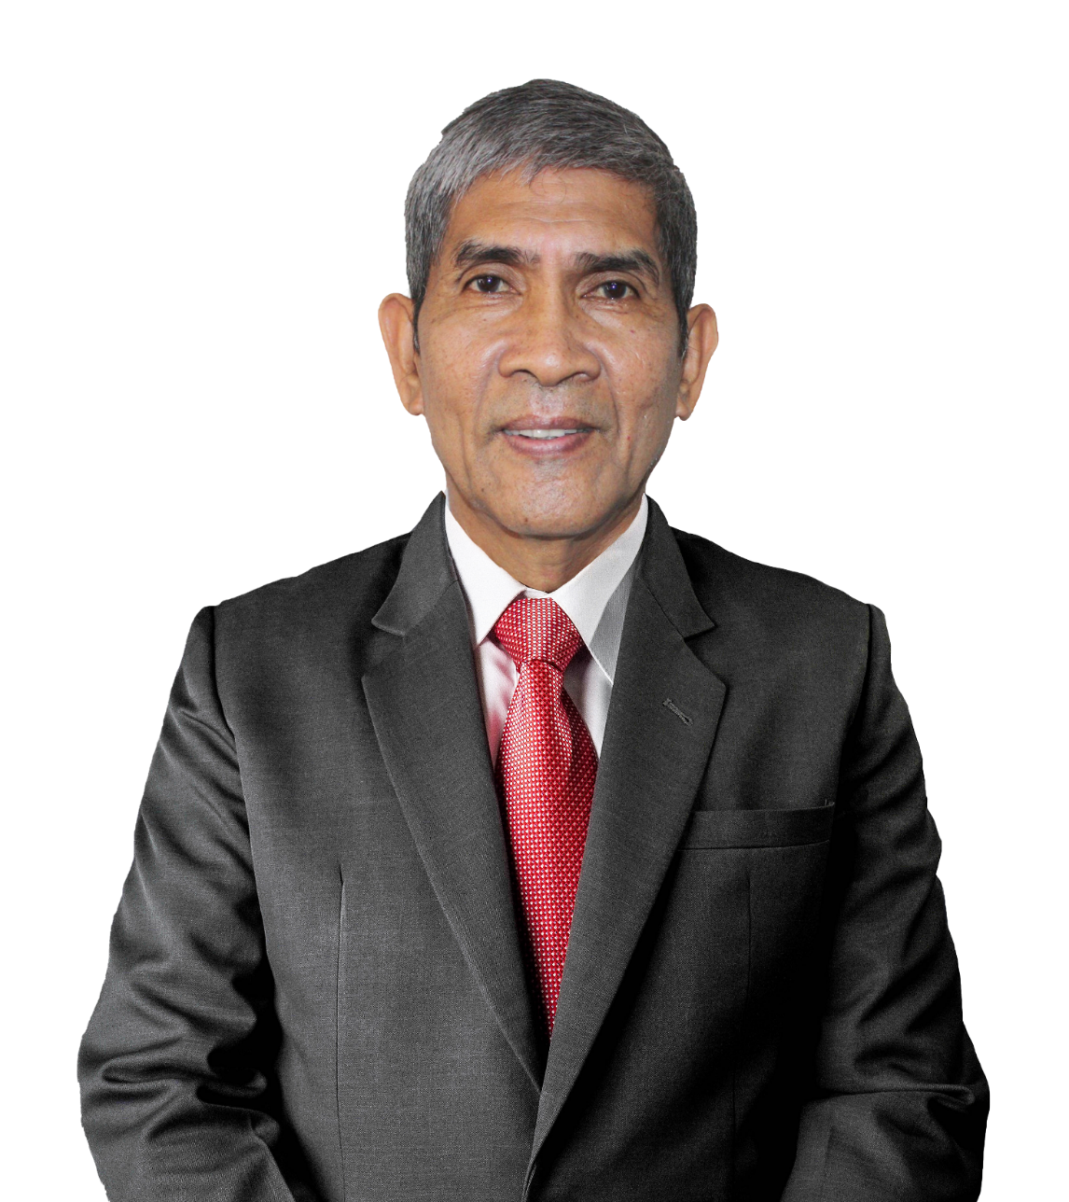
Nominee for the AFPMBAI Board of Trustees
Independent Trustee | MGen Rolando B Tenefrancia PA (Ret)
Age | 63 years old
Date of First Election | July 11, 2020
Relevant Academic Background and Training/Experience
Graduate School | Pamantasan ng Lungsod ng Maynila
Degree/Course | Master in Business Administration
Completed | 1995
Course | AFP Comptrollership Officer Basic
Completed | 1998
Relevant Training | Briefing on AFPMBAI Operations
Completed | 2020
Relevant Training | Continuing Education Program
Topics/Inclusive Dates | Business Model Shift: Pivoting Toward a New and Better Normal (August 26, 2020 Part I)
 | Strategic Thinking (August 28, 2020 Part II)
 | Latest Developments in the Mutual Benefit Association and Insurance Industry (September 24, 2020 Part III)
 | AMLA Webinar from IC (October 14, 2020 Part IV)
Relevant Training | Corporate Governance Seminar, Institute of Corporate Directors
Completed | August 4, 2020
Relevant Training | Seminar for AFP -FAO
Date | 22 August 1994
Seminar | Procurement on System and Procedure
Date | 22 August 1994
2021 ANNUAL GENERAL MEMBERSHIP MEETING

Slide 15
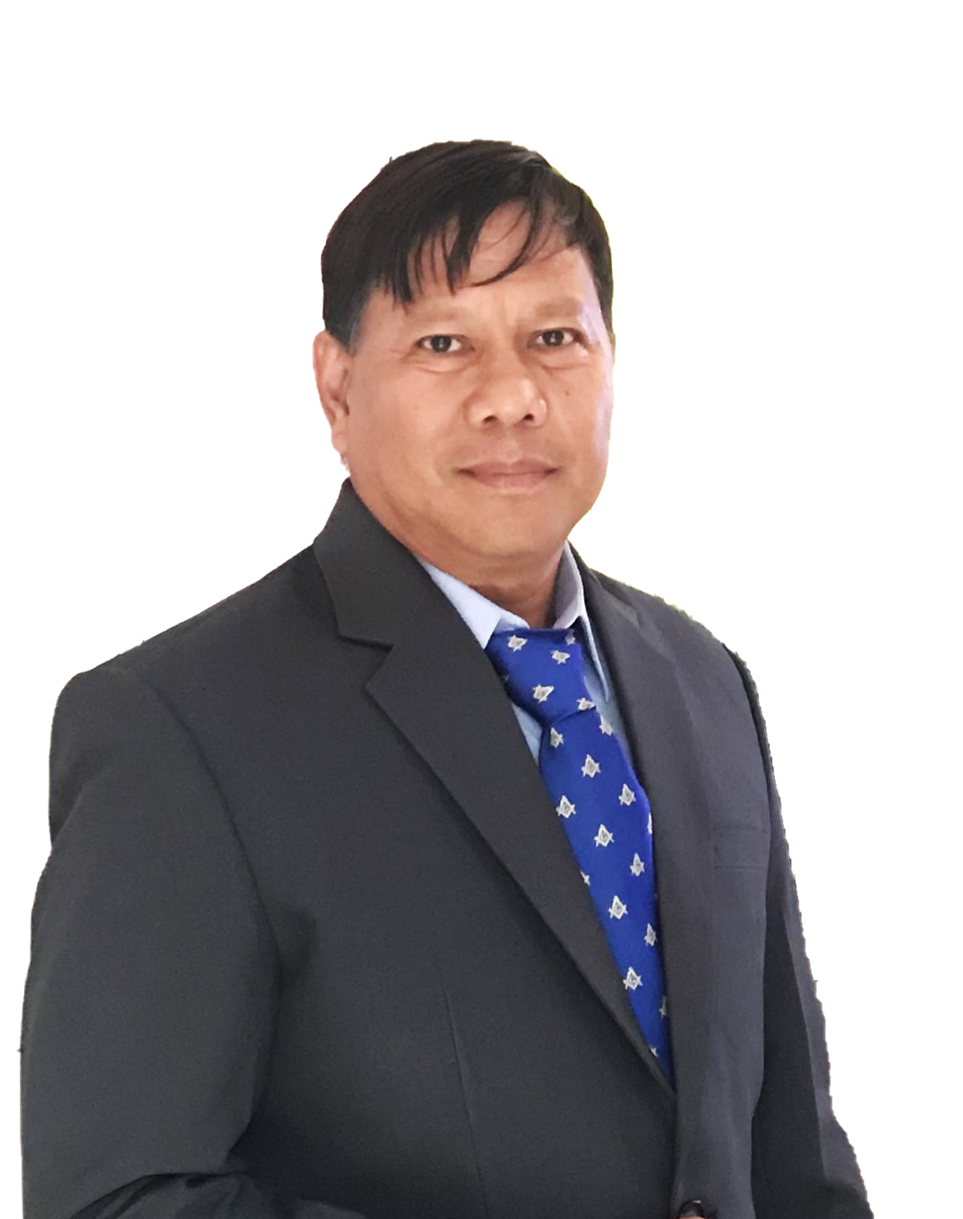
Nominee for the AFPMBAI Board of Trustees
Independent Trustee | MGen Tyne T Bañas PA (Ret)
Age | 56 years old
Date of First Election | May 15, 2021
Relevant Academic Background and Training/Experience
Graduate School | Univ of Wollongong, Australia
Degree/Course | Master of Strategic Human Resource Management
Completed | July 12, 2006
Relevant Training | Writing Effective Audit Report
Completed | February 7, 2015
Relevant Training | Course on Corporate Governance (ICD)
Completed | March 6, 2014
2021 ANNUAL GENERAL MEMBERSHIP MEETING

Slide 16
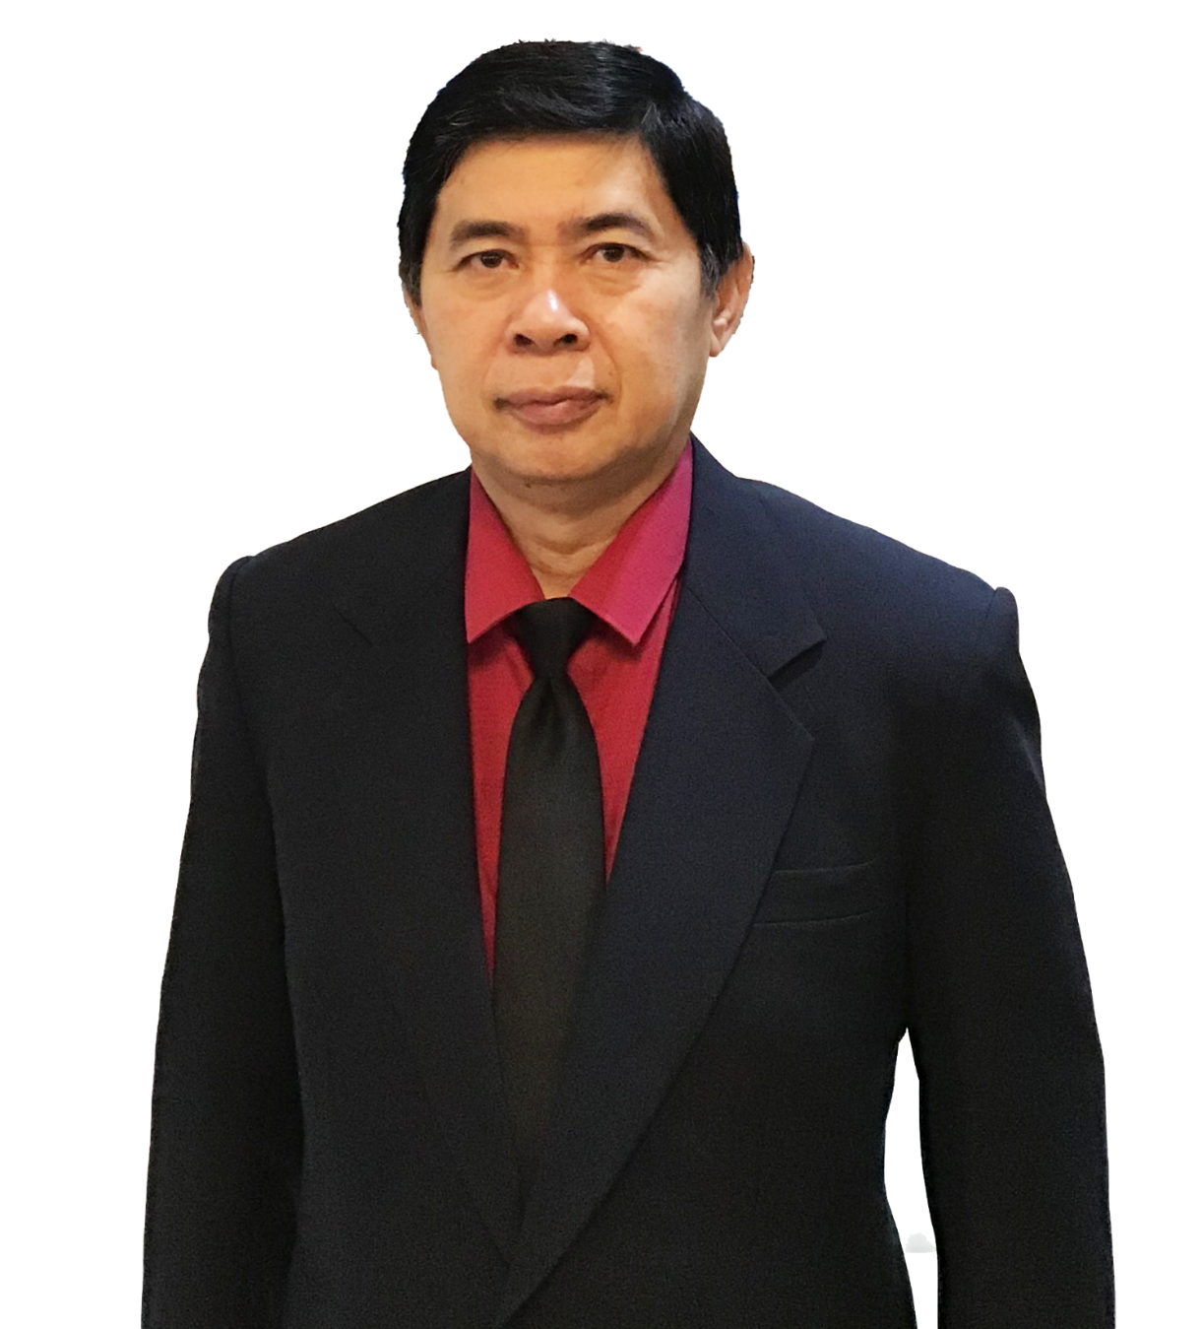
Nominee for the AFPMBAI Board of Trustees
Independent Trustee | BGen Virgilio B Bartolome PA (Ret)
Age | 57 years old
Date of First Election | May 15, 2021
Relevant Academic Background and Training/Experience
Graduate School | Philippine Christian University
Degree/Course | Master in Management
Completed | January 21, 2006
Graduate School | Philippine Christian University
Degree/Course | Master in Public Administration
Inclusive Date | 2005
Relevant Training | Comptroller Officer Basic Course
Completed | December 15, 1997
2021 ANNUAL GENERAL MEMBERSHIP MEETING

Slide 17

THANK YOU

