Slide 1



REPORT OF THE
NOMINATION COMMITTEE
These are the nominees for the representatives of AFPMBAI’s member organizations in
the AFP, PNP, PCG, BFP and BJMP as of 1 July 2020.
2020 ANNUAL GENERAL MEMBERSHIP MEETING

Slide 2
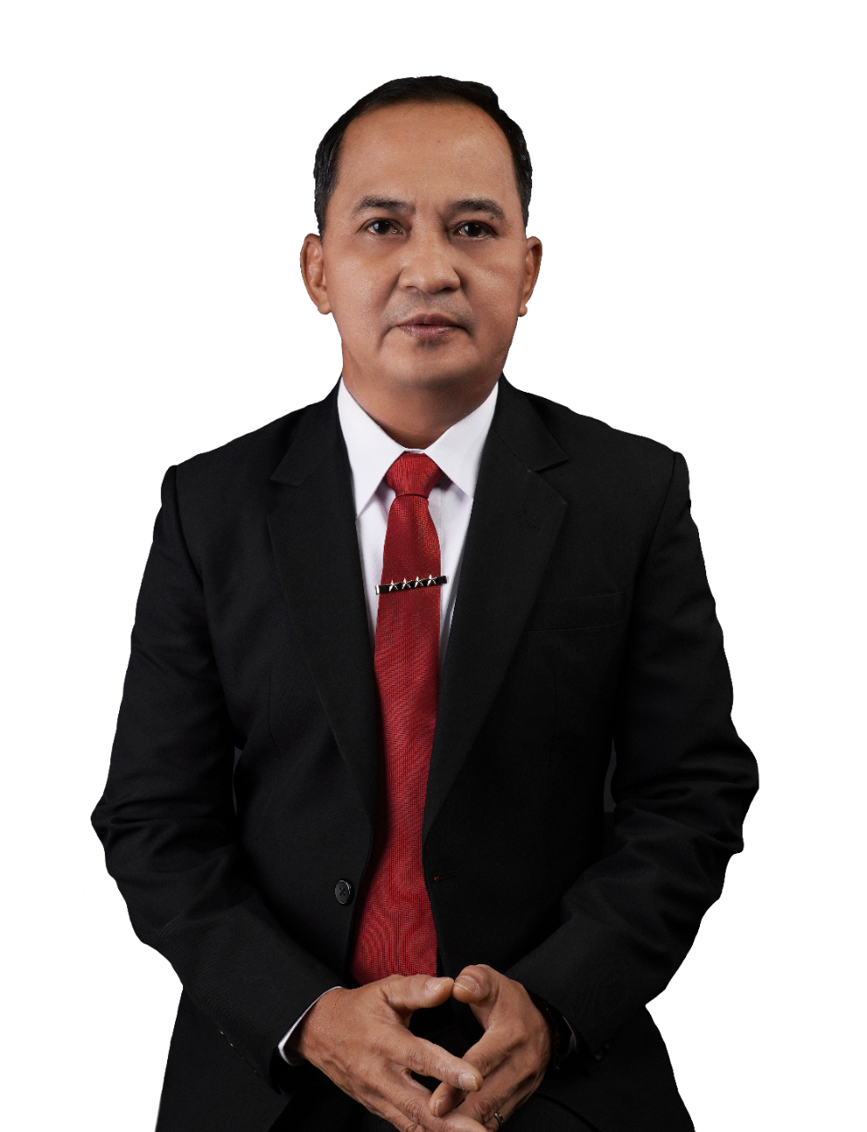
Profile of Nominees for the AFPMBAI Board of Trustees
Trustee – Representative from the Office of the AFP Chief of Staff | Gen Felimon T Santos Jr PA
Age | 55 years old
Date of First Election | February 5, 2020
Relevant Academic Background and Training
Graduate School | Philippine Christian University
Degree/Course | Master in Management
Completed | March 2005
Course | Strategic Thinking in Times of Pandemic
Completed | April 2020
Course | Corporate Governance Orientation Program
Completed | March 2020
Course | Comptrollership Course
Completed | December 1997
2020 ANNUAL GENERAL MEMBERSHIP MEETING

Slide 3
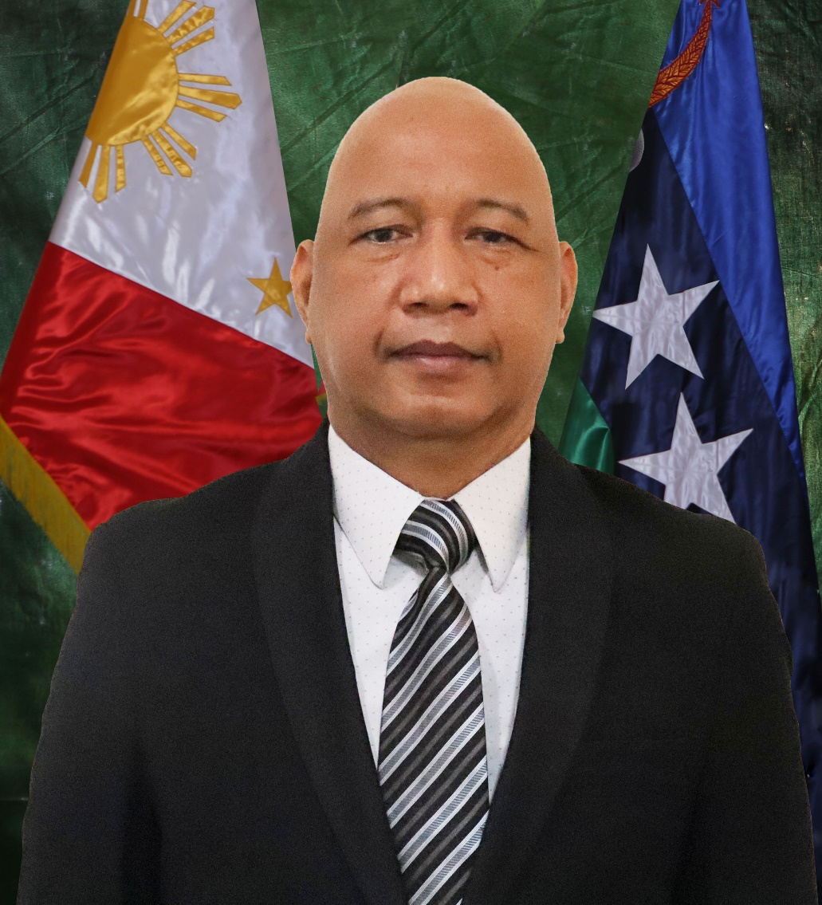
Profile of Nominees for the AFPMBAI Board of Trustees
Trustee - AFP Joint Staff Representative | MGen Adriano S Perez Jr PA
Age | 53 years old
Relevant Academic Background and Training
Graduate School | Philippine Christian University
Degree/Course | Master of Arts in Management
Completed | September 2007
Relevant Training | Financial Statement Analysis
Completed | January 2001
Relevant Training | Strat Human Resources Management
Completed | February 2002
Relevant Training | Professional Directors Program
Completed | June 2016
2020 ANNUAL GENERAL MEMBERSHIP MEETING

Slide 4
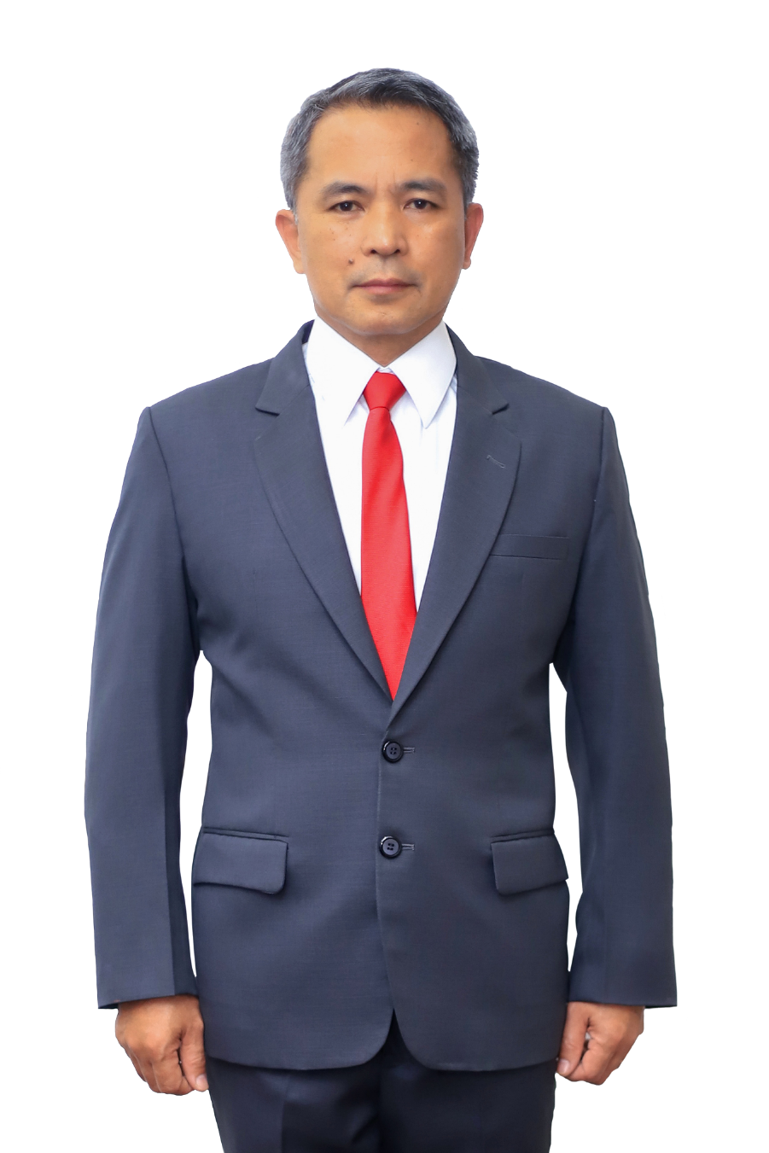
Profile of Nominees for the AFPMBAI Board of Trustees
Trustee – PA Representative | MGen Reynaldo M Aquino PA
Age | 55 years old
Date of First Election | July 29, 2019
Relevant Training
Course | Corporate Governance Orientation Program
Completed | October 2019
2020 ANNUAL GENERAL MEMBERSHIP MEETING

Slide 5
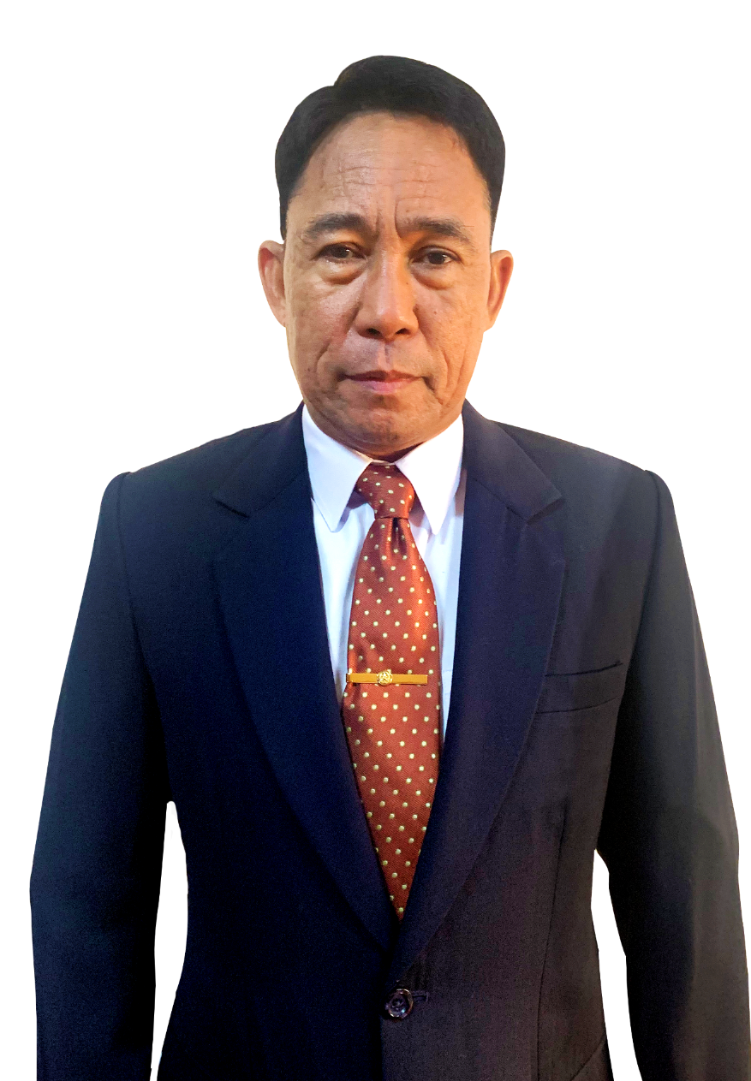
Profile of Nominees for the AFPMBAI Board of Trustees
Trustee – PN Representative | RAdm Rey T Dela Cruz PN
Age | 55
Date of First Election | May 4, 2020
Relevant Academic Background and Training
Graduate School | University of New South Wales (Australia)
Degree/Course | Master in Management Studies-Project Management
Completed | July 2002
Course | Strategy Formulation and Implementation Seminar
Completed | November 2013
2020 ANNUAL GENERAL MEMBERSHIP MEETING

Slide 6
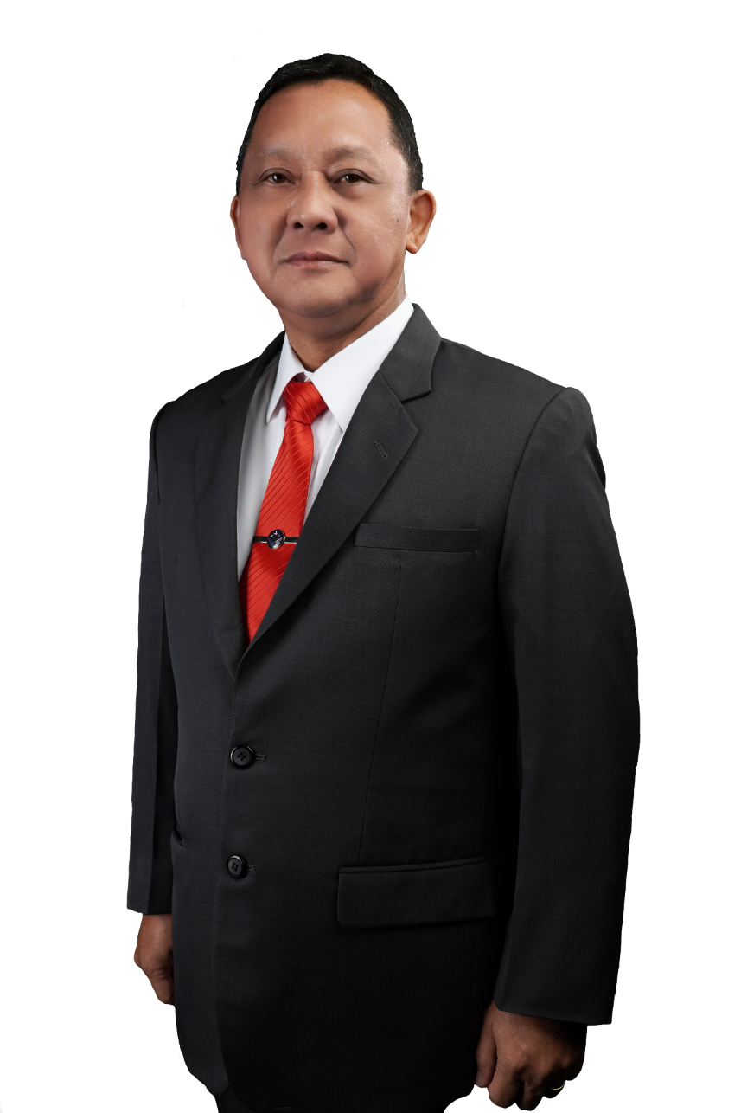
Profile of Nominees for the AFPMBAI Board of Trustees
Trustee – PAF Representative | MGen Pelagio R Valenzuela PAF
Age | 54 years old
Date of First Election | September 27, 2019
Relevant Academic Background and Training
Graduate School | Philippine Christian University
Degree/ Course | Master of Management Major in Public Administration
Completed | 2001
Course | Corporate Governance Orientation Program
Completed | March 5, 2020
Course | Financial Investigation Training
Completed | October 2006
2020 ANNUAL GENERAL MEMBERSHIP MEETING

Slide 7
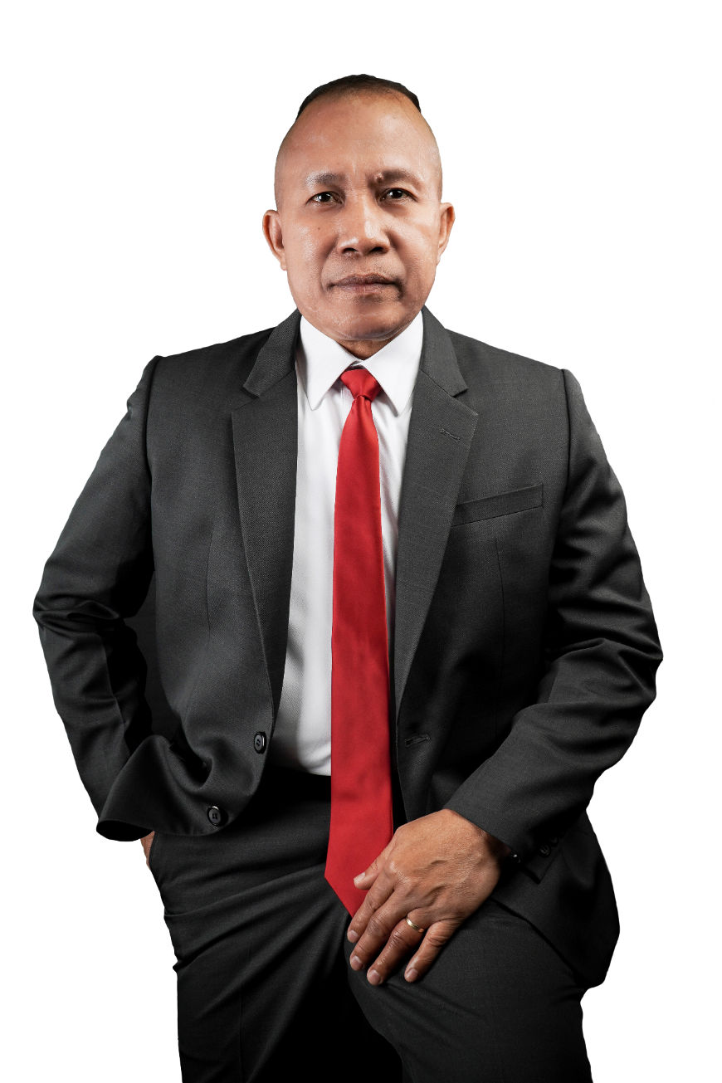
Profile of Nominees for the AFPMBAI Board of Trustees
Trustee - Representative from the Office of the AFP Sergeant Major | FCMS Engracio S Gabo Jr (INF) PA
Age | 55 years old
Date of First Election | July 29, 2019
Relevant Training
Course | Corporate Governance Orientation Program
Completed | October 2019
2020 ANNUAL GENERAL MEMBERSHIP MEETING

Slide 8
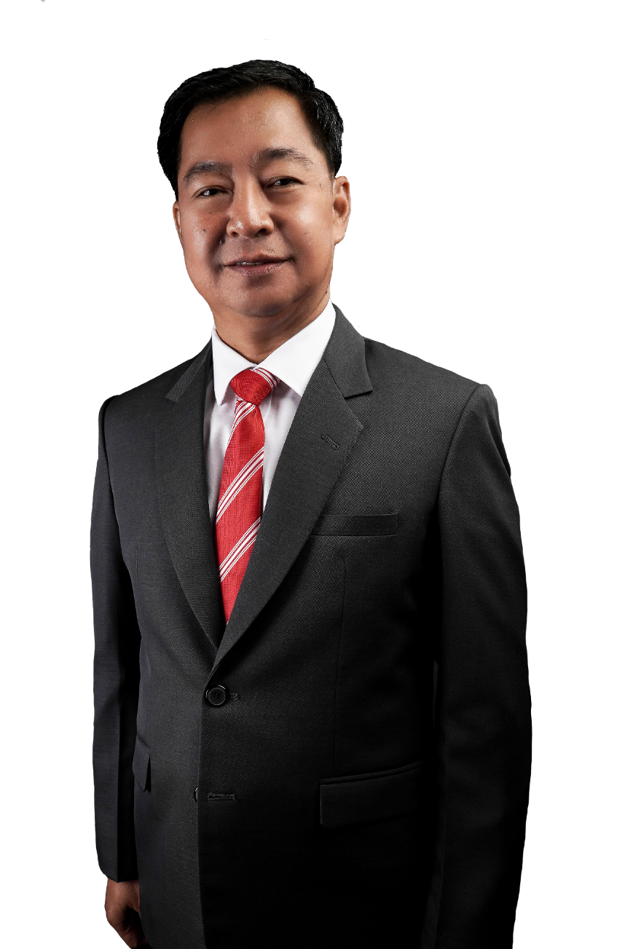
Profile of Nominees for the AFPMBAI Board of Trustees
Trustee – PNP Representative | PMGen Alfred S Corpus
Age | 54 years old
Date of First Election | January 25, 2018
Relevant Academic Background and Training
Graduate School | Philippine Christian University
Degree/Course | Master of Arts in Management
Completed | 2006
Relevant Training | Corporate Governance Orientation Program
Completed | March 2018
2020 ANNUAL GENERAL MEMBERSHIP MEETING

Slide 9
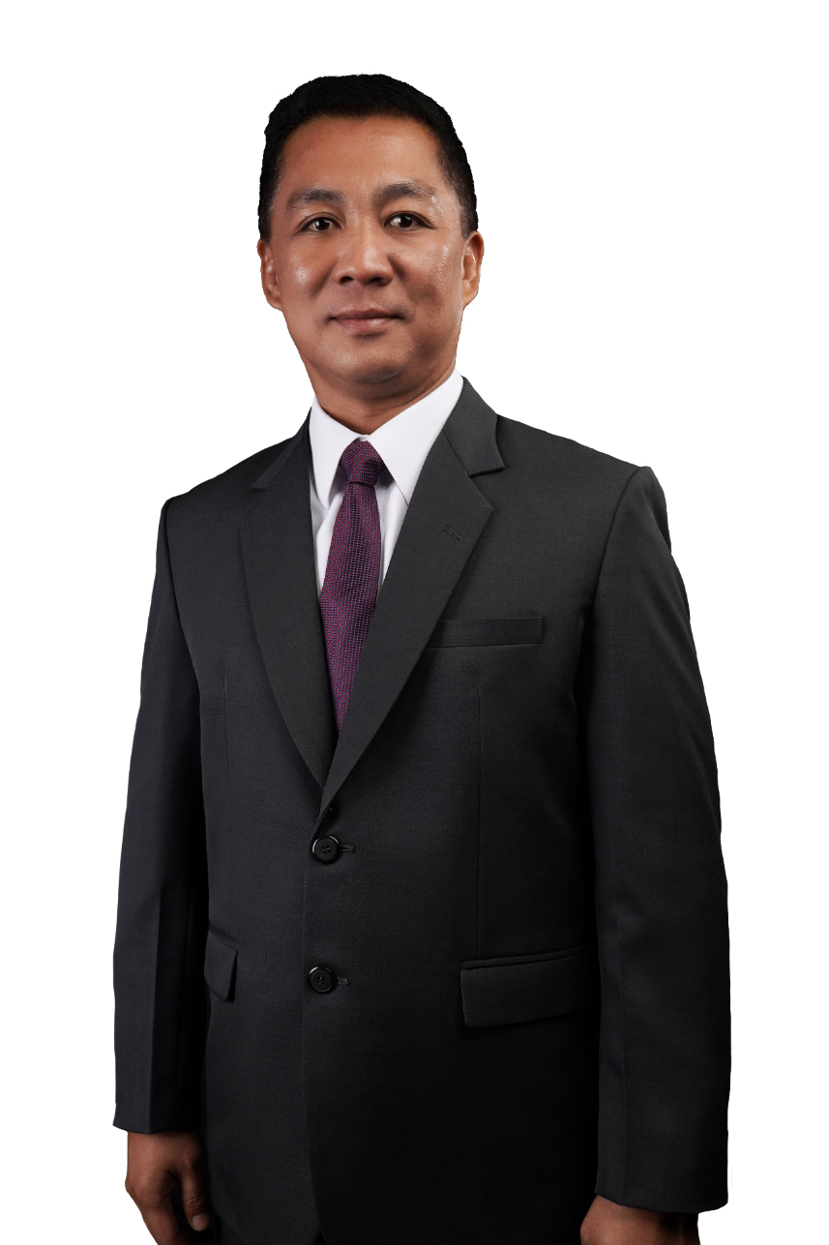
Profile of Nominees for the AFPMBAI Board of Trustees
Trustee – PNP Representative | PCol Jose Melencio C Nartatez Jr
Age | 48 years old
Date of First Election | November 7, 2018
Relevant Academic Background and Training
Graduate School | Polytechnic University of the Philippines
Degree/Course | Master in Public Administration
Completed | 2007
Relevant Training | Corporate Governance Orientation Program
Completed | September 2018
2020 ANNUAL GENERAL MEMBERSHIP MEETING

Slide 10
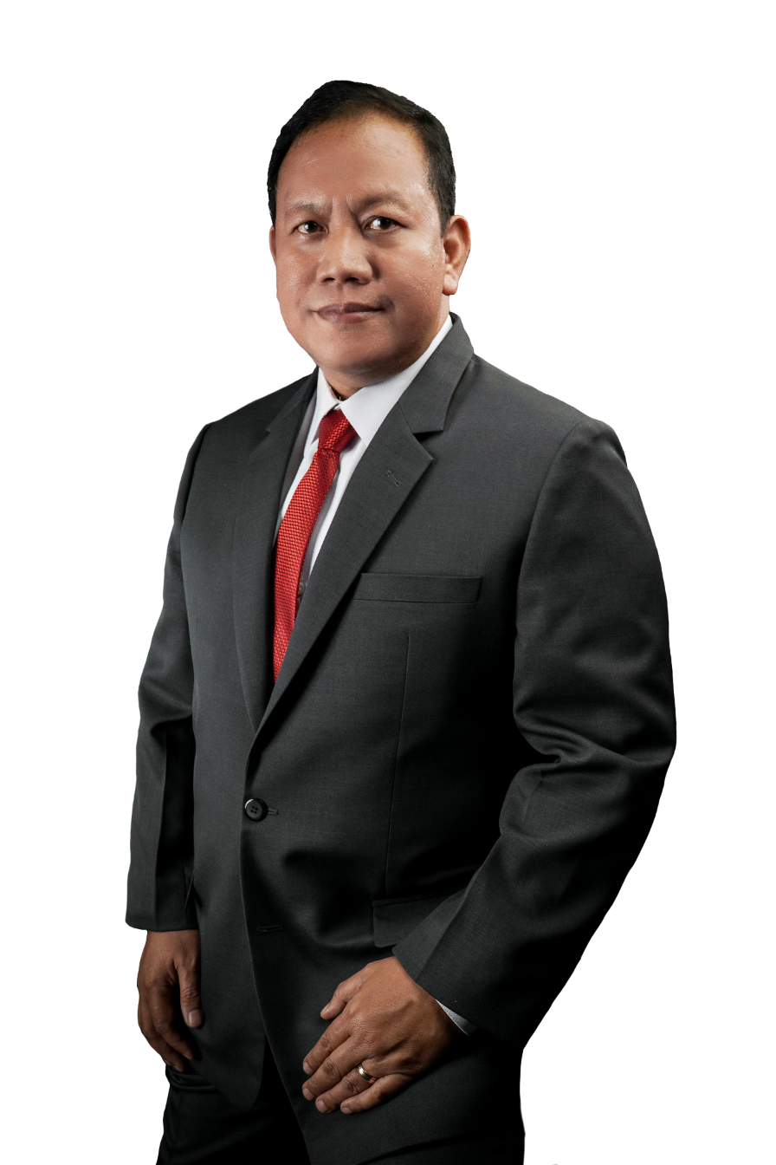
Profile of Nominees for the AFPMBAI Board of Trustees
Trustee – PCG Representative | VAdm Leopoldo V Laroya PCG
Age | 53 years old
Date of First Election | September 27, 2019
Relevant Training
Course | Corporate Governance Orientation Program
Completed | October 2019
2020 ANNUAL GENERAL MEMBERSHIP MEETING

Slide 11
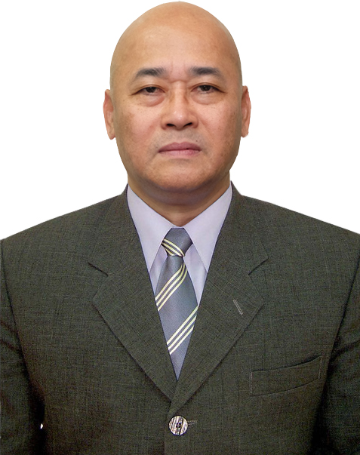
Profile of Nominees for the AFPMBAI Board of Trustees
Trustee – BFP Representative | CSupt Roel Jeremy G Diaz BFP
Age | 54 years old
Date of Fist Election | June 10, 2020
Relevant Academic Background and Training
Graduate School | University of Iloilo
Degree/Course | Master in Public Administration
Completed | 2002
Law School School | University of Iloilo
Degree/Course | Bachelor of Laws (LLB)
Completed | 2000
Relevant Training | Course on Basic Policy Process (DAP)
Completed | March 2016
2020 ANNUAL GENERAL MEMBERSHIP MEETING

Slide 12
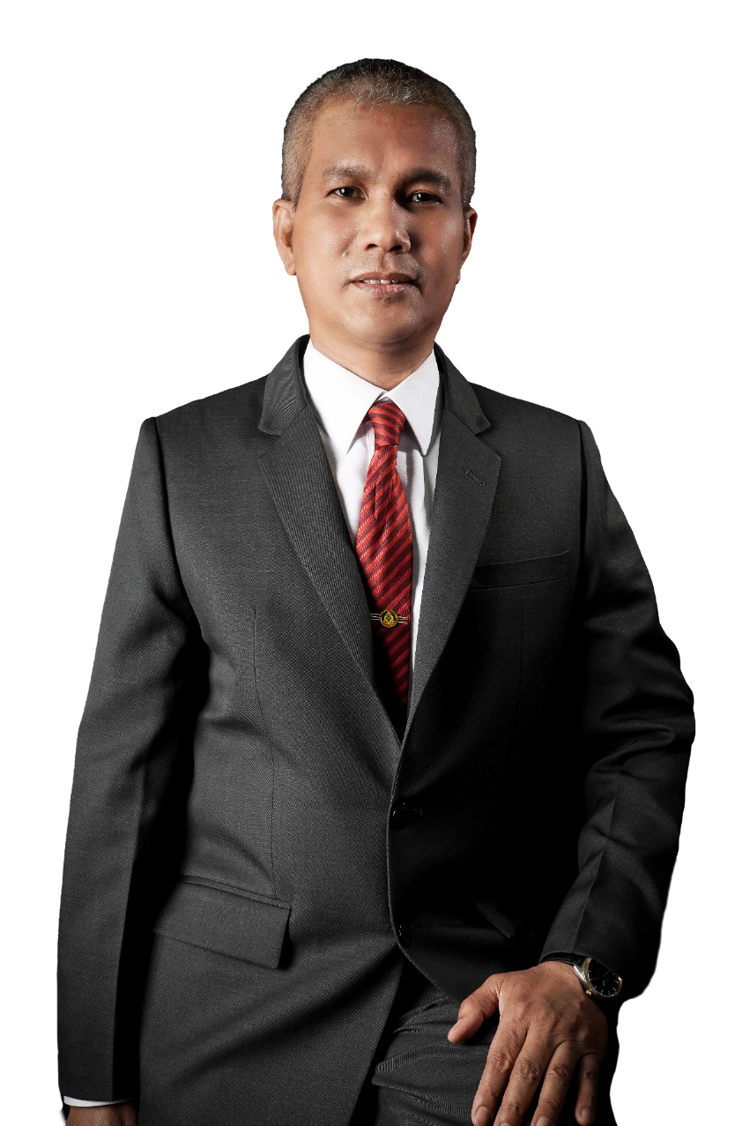
Profile of Nominees for the AFPMBAI Board of Trustees
Trustee – BJMP Representative | CSupt Ruel S Rivera BJMP
Age | 50 years old
Date of First Election | May 18, 2019
Relevant Academic Background and Training
Graduate School | Batangas State University
Degree/Course | Master in Public Administration
Completed | 1999
Relevant Training | Corporate Governance Orientation Program
Completed | August 2019
Relevant Training | Exec Course on Money Laundering and Terrorism Financing
Completed | March 3, 2012
Relevant Training | Seminar on Financial Resources, Ethics and Accountability
Completed | April 9, 1994
2020 ANNUAL GENERAL MEMBERSHIP MEETING

Slide 13
REPORT OF THE
NOMINATION COMMITTEE
Per 2020 Annual General Membership Meeting (AGM)
Rules on Nomination, the AFP Chief of Staff
may submit his nominees on the day of the AGM.
2020 ANNUAL GENERAL MEMBERSHIP MEETING

