Slide 1

Report of the President & CEO
MGEN RIZALDO B LIMOSO PA (RET)
Notes:
Greetings…..

Slide 2



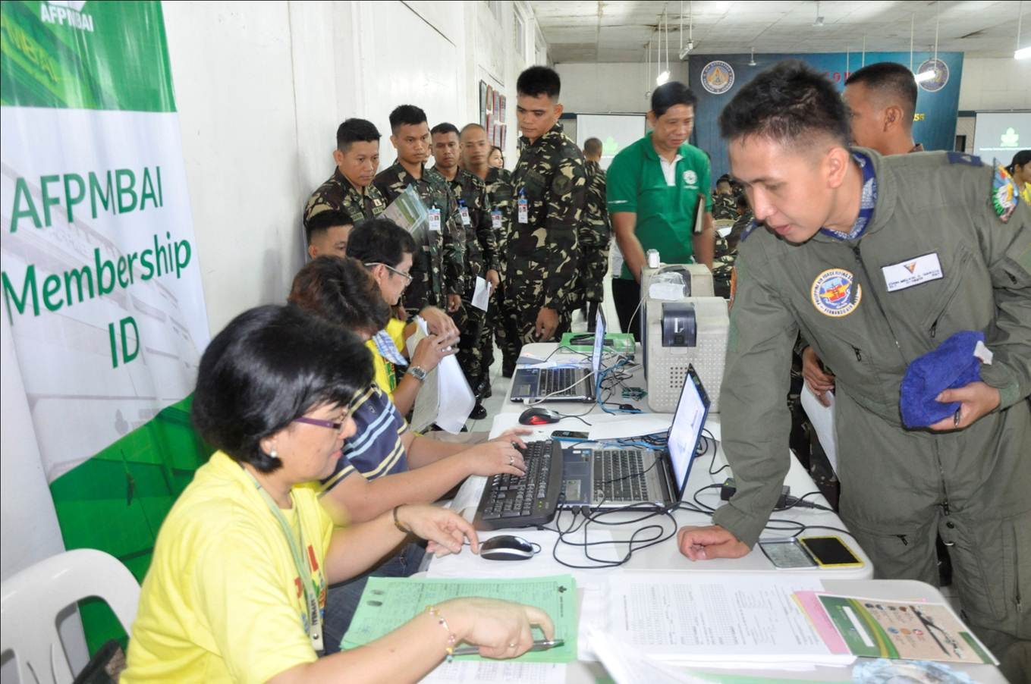

SERVICE
IN TIME OF NEED
Notes:
Rooted from the spirit of giving assistance during times of adversity, AFPMBAI withstood the challenges of pandemic for CY 2020. This time more than ever, the AFPMBAI surged on and painstakingly pursued its operations by immediately adapting to the circumstances of the “new normal”. Thus, during the early onslaught of COVID 19 and more so during the height of this health crisis, AFPMBAI was the only Financial Institution that remained in operation while the others went on total lockdown.

Slide 3



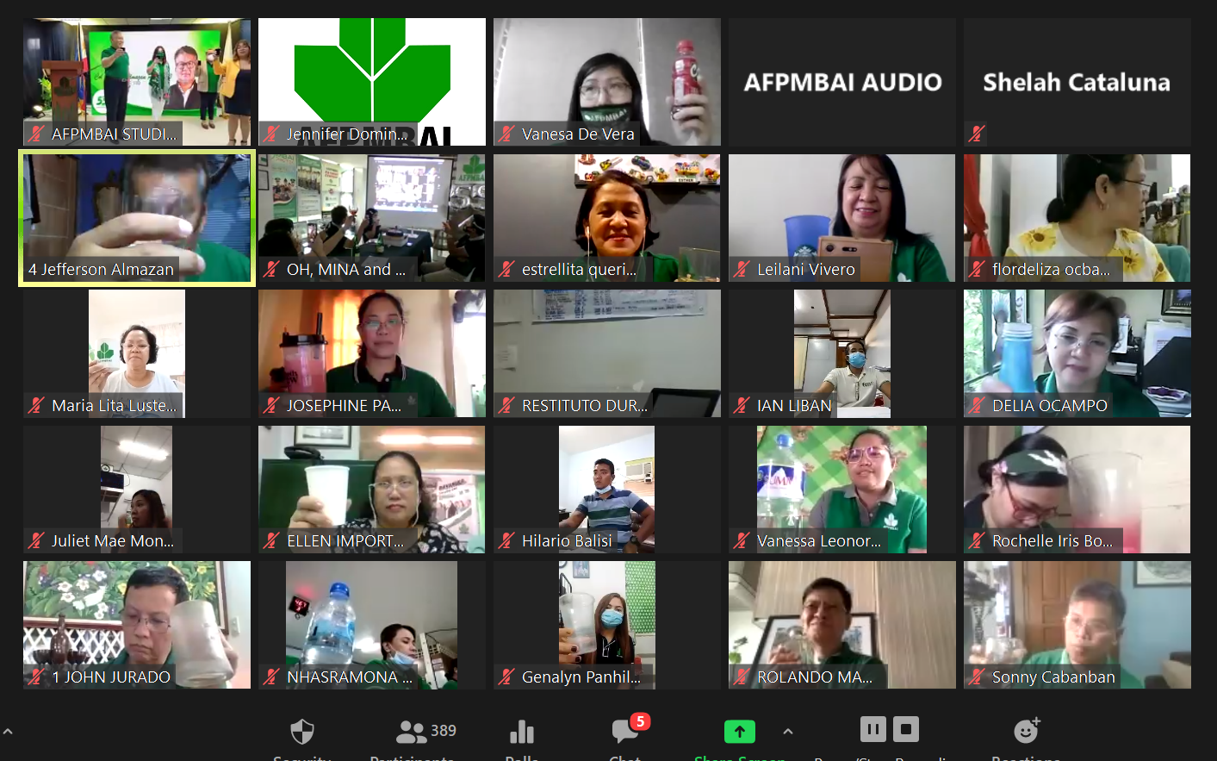
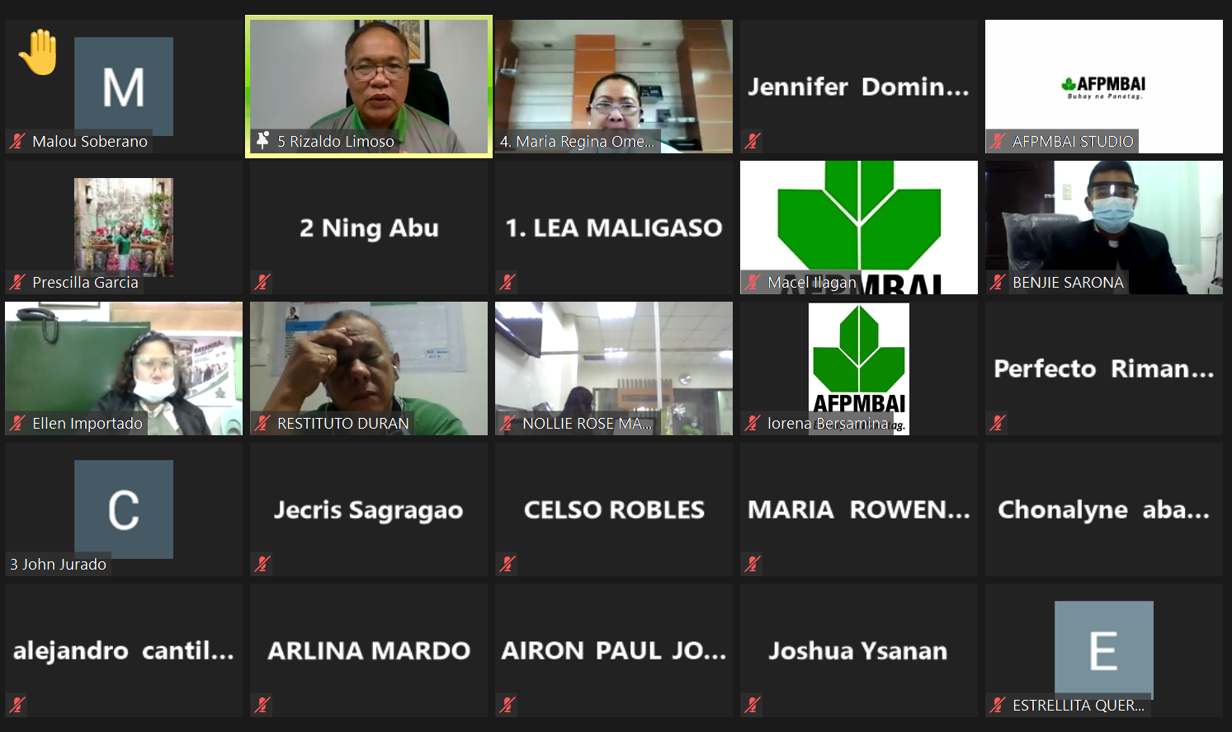
Notes:
Through its Business Continuity Plan (BCP) and its virtual conduct of meetings, the Management ensured the continuous operations of the Association through a skeletal force provided with a back-end support while enforcing highly restrictive health protocols imposed at the national as well as at the local government level.

Slide 4
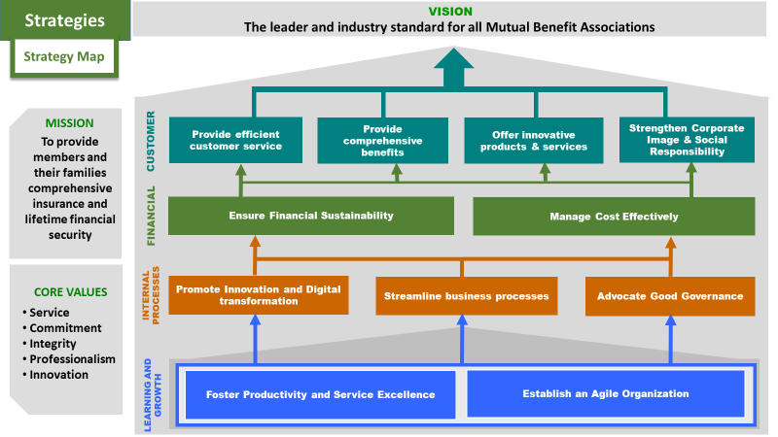
PLANS AND PROGRAMS
BUDGETS AND TARGETS
MITIGATING COST STRATEGIES
Notes:
Still guided by our approved plans and programs for the year, we updated what we have laid out by realigning our budget and recalibrating our targets to ensure that our strategies and initiatives were still viable under the new normal. These contingency measures were then approved by the Board of Trustees which we immediately deployed to mitigate the effects of this disruption in the attainment of our financial as well as on our operational objectives.

Slide 5

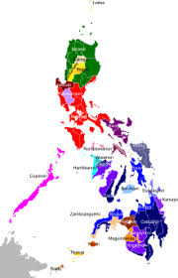


PRIORITY STRATEGIES
DIGITAL
TRANSFORMATION
CAPACITY
BUILDING
BUSINESS PROCESS
IMPROVEMENT
&
INNOVATION
DEVELOPMENT OF
ORGANIZATIONAL
& HUMAN CAPITAL
Notes:
For CY2020 we prioritized four (4) major initiatives from among our strategies, to wit: Digital Transformation, Capacity Building, Business Process Improvement and Innovation, and the Development of Organizational and Human Capital. Most of our accomplishments for the year revolved around these 4 areas as we believed that we would be most responsive to the needs of our members by optimizing the use of our resources as we maneuver our service deliveries in the myriad of restrictions brought about by the pandemic.

Slide 6





DIGITAL TRANSFORMATION
Real Estate Monitoring System (REMS)
Electronic Point of Sale System (e-Poss)
Notes:
DIGITAL TRANSFORMATION
Our digital transformation efforts centered mainly in the development of the remaining modules of Accedata, our Insurance and Loans Information System, crafting of Real Estate Accounts Monitoring System, Inventory System and Electronic Point of Sale System (e-Poss). We also continued with the 2nd phase of the digitization of all our AFPMBAI records using the Document Management System (DMS).

Slide 7
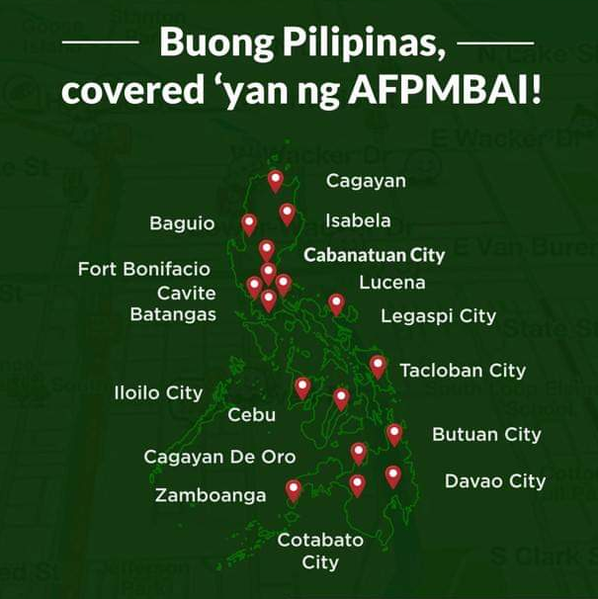

CAPACITY BUILDING
Branches
&
Extension Offices
Notes:
CAPACITY BUILDING
To capacitate/strengthen our regional branches and offices, we allowed some of our workforce to work from home to act as back end support while some reported on site to attend directly to some of our customers despite the physical restrictions on mobility. Also, we adopted the concept of “Balik Probinsya Program” of the government where personnel were allowed to go home to their provinces and report to the nearest regional branch or extension office. This, along with the beefing up of personnel in the branches enabled our extension offices to process and release claims instead of just merely accepting loans and insurance applications from the members.

Slide 8



BUSINESS PROCESS IMPROVEMENT & INNOVATION
Task Rationalization & Decentralization
Notes:
BUSINESS PROCESS IMPROVEMENT & INNOVATION
We also revisited our business processes where we improved our insurance application by task rationalization, decentralization and regularization of certain processes. We had plenty of work discussions particularly at top level echelons and designed and implemented measures to cut on Turn Around Time of deliveries for certain phases of our insurance processing particularly in encoding and underwriting applications. Along this line, we also engaged a business solution expert to help us in the initial documentation of all our core business processes.

Slide 9
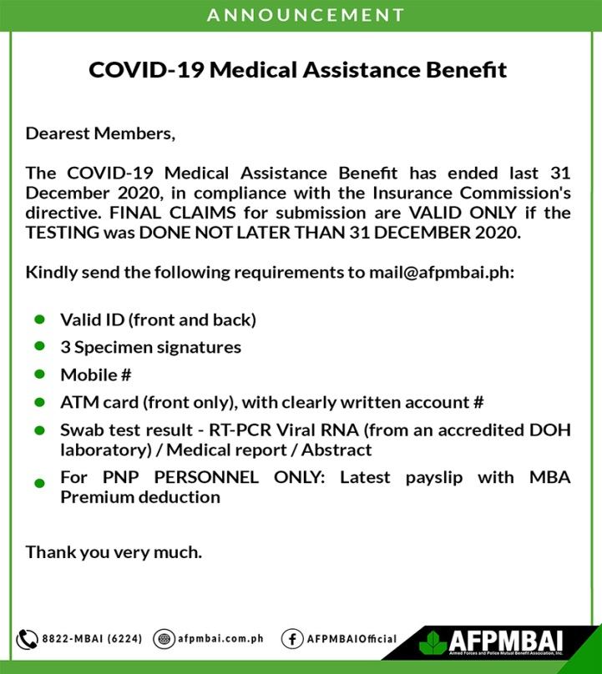


BUSINESS PROCESS IMPROVEMENT & INNOVATION
Comprehensive AFPMBAI Membership Program (CAMP)
Notes:
We also made innovations on some features of our existing products and launched new products that can be more useful and beneficial to the members, including those who are no longer in the service thru the adoption of the following programs and product:
Grant of Free Benefit of COVID-19 Medical Assistance and KIA Benefit (CFAB Program) to frontliner-members infected with to include those who died from COVID-19
Launch of Emergency Loan Program that is with the lowest interest rate (5.0% p.a.) last April to help extend financial assistance to members during the pandemic
Launch of the Comprehensive AFPMBAI Membership Program (CAMP)
Implementation of the first phase of lowered premium rates for convenient loan borrowing through our Credit Redemption Insurance (CRI)

Slide 10


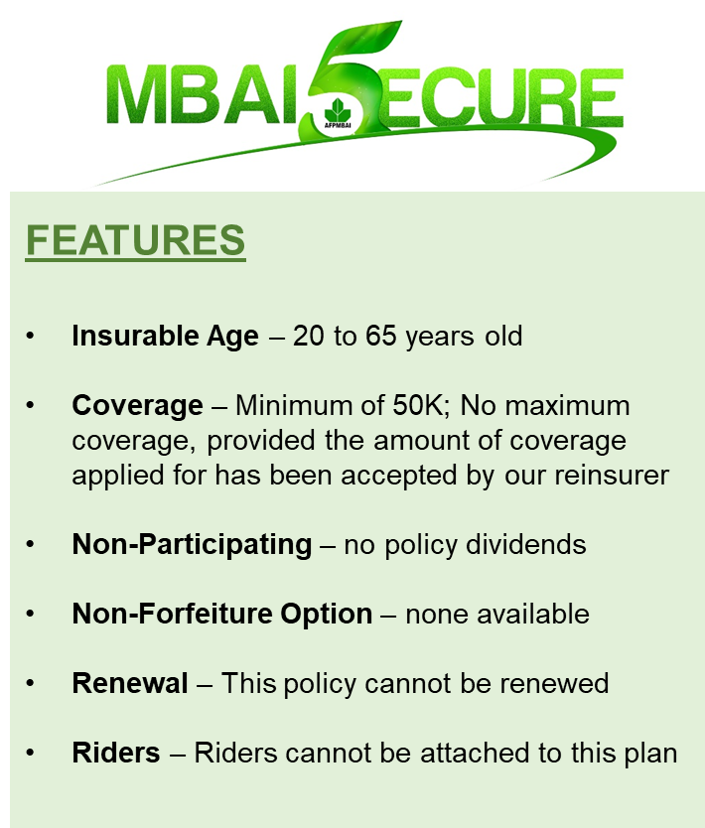
BUSINESS PROCESS IMPROVEMENT & INNOVATION
For Retired
&
Associate Members
MEDAL
(Enhanced Members’ Educational
Assistance Loan)
Notes:
Grant of the Enhanced Members’ Educational Assistance Loan (MEDAL) with a lower interest rate (6.0% p.a.) and increased loanable amount and payment terms (P100K, payable up to 3 years) to further help our members’ needs for their children’s education
Launch of MBAI 5ecure (5-Year Term Insurance), a new insurance product focusing on member protection
Launch of MBAI iProtek, a Basic membership insurance for Retired and Associate Members

Slide 11



BUSINESS PROCESS IMPROVEMENT & INNOVATION
New Work Arrangement
Notes:
In time for the new normal set-up, we have also implemented our Human Resource System called Thread. Due to the implementation of a new work arrangement, Thread has become a useful tool for the attendance recording and monitoring of all employees reporting on site, working from home (WFH) or attending an official business.

Slide 12







BUSINESS PROCESS IMPROVEMENT & INNOVATION
Auto-credit Facility with Landbank
On line Banking
UnionBank
Other Affiliated
payment centers
Notes:
We have also utilized Online Banking with UnionBank for our disbursement transactions and the Auto-credit Facility with Landbank for payment of claims and benefits to members. These are added facilities to our existing affiliated payment centers at UCPB, Metrobank, SM, Palawan Pawnshop Express Padala and LBC.

Slide 13





DIGITAL PRESENCE
AFPMBAIOfficial
AFPMBAI
AFPMBAIOfficial
Notes:
The Association also rode with the trend of the most sought platform of online customer portals and digital brand presence through the following:
Enabled online submission of members’ loan and benefit claim applications from the start of the community quarantine in March (centralized thru Customer Service)
AFPMBAI continued as the #1 in digital presence among all financial institutions with 109,000 Followers, growing by 52% year-on-year
Launched a newly-designed and more informative website (www.afpmbai.com.ph)
Posted informative and engaging content on AFPMBAI’s official social media accounts (@afpmbaiofficial)
Conducted first monthly radio show on DWDD-AM (1134 kHz, with livestreaming on Facebook), named “MBAI-Connect”
Started regular webinars on AFPMBAI products & services for new graduates/recruits from the different branches of service

Slide 14
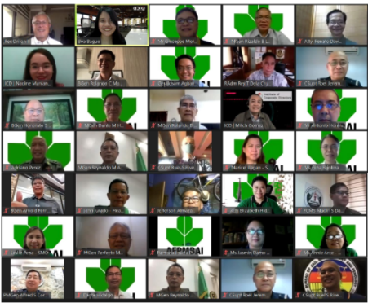

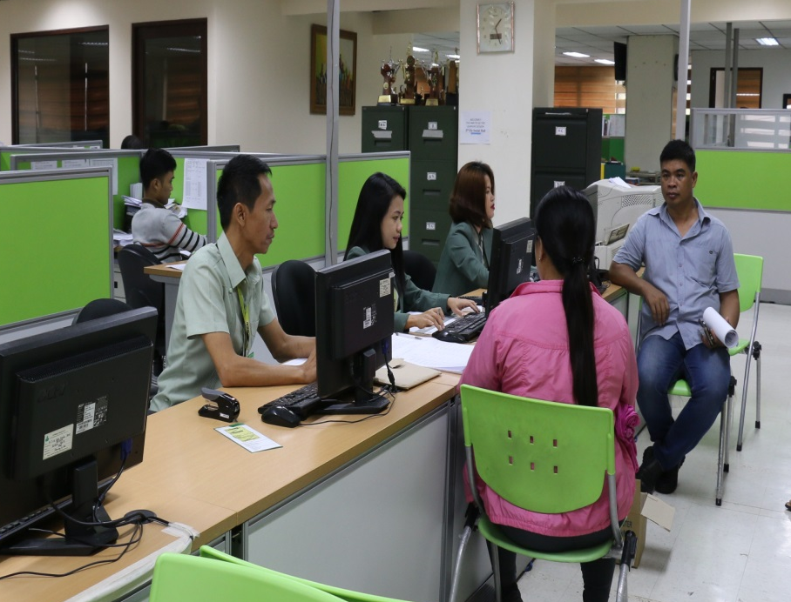
DEVELOPMENT OF ORGANIZATIONAL & HUMAN CAPITAL
Notes:
The pandemic also gave us time to capacitate our personnel in terms of new skill development as part of our learning and growth strategy to better serve the members. Several of the employees were sent to various on-line seminars ranging from strategies related to the pandemic, crisis handling and employee safety, to provide them new perspectives in handling situations under the new normal.

Slide 15


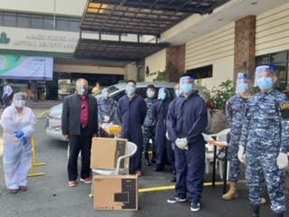

DEVELOPMENT OF ORGANIZATIONAL & HUMAN CAPITAL
Establishment of Safety and Health Program
Notes:
The Association also implemented a comprehensive Safety and Health Program to ensure safety of our employees. Rapid Tests and PCR Testing were administered to employees who have been exposed to COVID-19 and a Medical Assistance in the form of financial assistance thru payment of a portion of their hospital expenses, medicine subsidy and food allowance in quarantine areas were also granted to employees contracting the said virus.

Slide 16
CLAIMS AND BENEFITS GRANTED
Death Claims | P170.3 M | 930
Living Claims | P1.2 B | 18,073
Comprehensive Financial Assistance Benefits (CFAB) | P170.2 M | 18,597
(Battle Injury Assistance, Wounded In Action, Killed In Action, Burial)
Notes:
CLAIMS AND BENEFITS GRANTED
The Association, during the period has provided financial services to the members through its insurance loans, living and death claims of their insurance policies.
Death claims totaled P170.3 million for 930 members and living claims at P1.2 billion for 18,073 members with P170.2 million worth of Comprehensive Financial Assistance Benefit (CFAB) from both living and death claims.
The said CFAB program is the most generous offering of benefits that provided additional cash benefits for the families of our fallen and wounded members at no additional cost.

Slide 17


BENEFITS GRANTED
Real Estate Mortgage Loan | P356.14 M
Real Estate Housing Loan | P16.04 M
Notes:
Grants for Real Estate Mortgage Loans totaled P356.14 Million and grants of P16.04 Million for Housing Loans.

Slide 18

CLAIMS AND BENEFITS GRANTED
Policy Dividends P117.94 M
benefiting 183,980 AI & E-56
policy holders
Notes:
Moreover, the Association declared policy dividends amounting to P117.94 million benefitting 183,980 AI & E-56 policy holders.

Slide 19


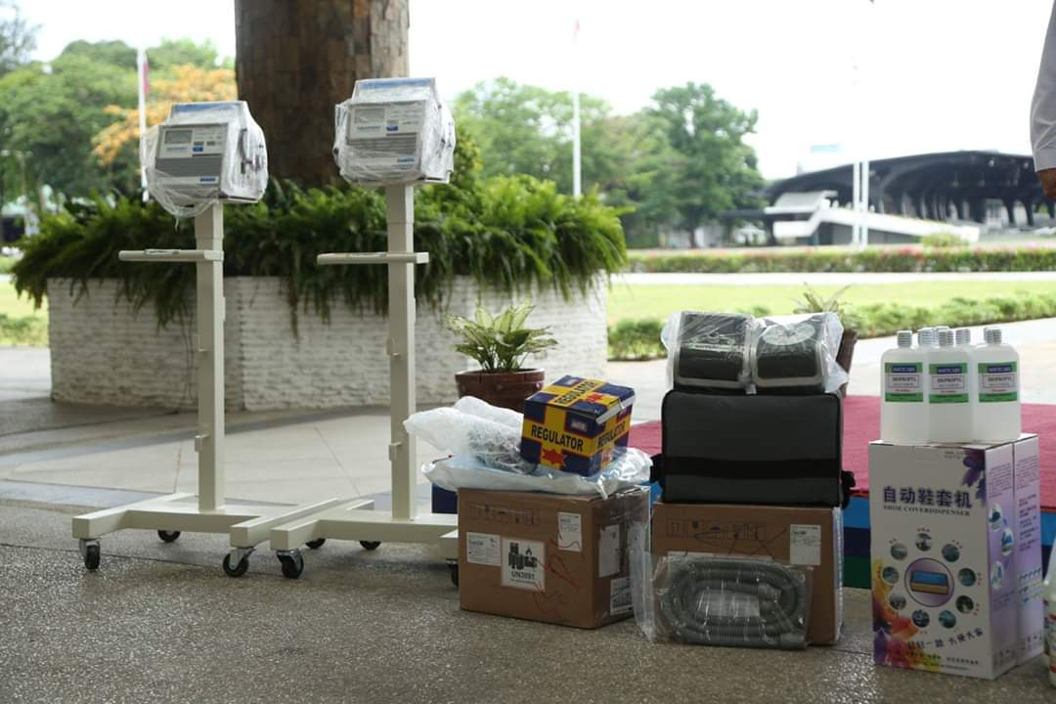
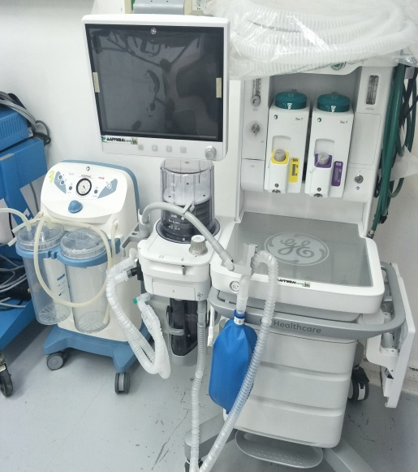

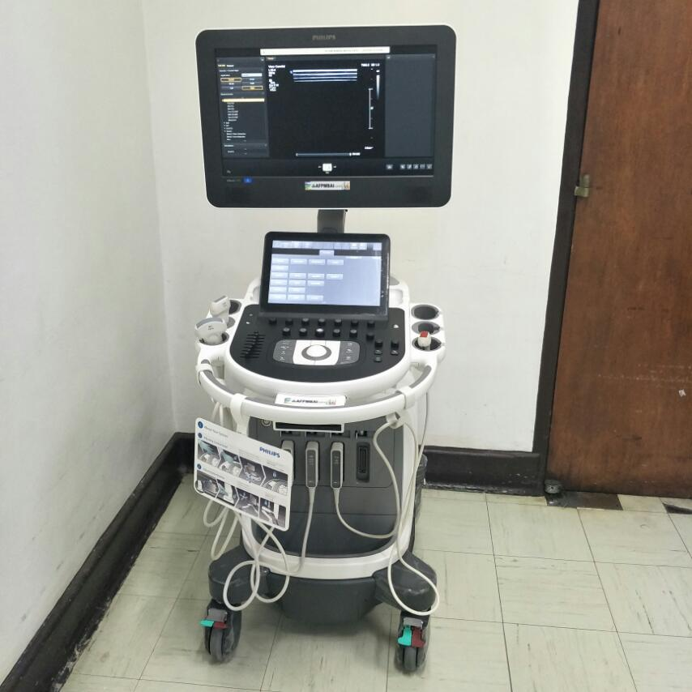

COVID-19 RELATED INITIATIVES
Notes:
COVID-19 RELATED INITIATIVES
Responding to the greater need of reaching out to its members to help in their fight against the effects of COVID 19, the Association allotted the additional Budget of P100 million to its CSR projects to address the medical requirements of the different branches of service. This is aside from the CSR budget for the year that covered the flagship programs of education, health, livelihood and general welfare.

Slide 20

COVID-19 RELATED INITIATIVES
Notes:
The Association also heeded the call of Government’s Bayanihan Heal as One Act 1 and 2 by granting moratorium on monthly loan payments for the months of April to May and November to December in 2020. This was accompanied by an Opt-Out option granted to availing members for their insurance premiums in November and December, per directive of the Insurance Commission (IC). This greatly affected the revenue generation of the Association as it had to defer the use of revenue funds for investment purposes in favor of alleviating the financial burden experienced by the members by way of us postponing our collection of their payments on their loan obligations during the period.

Slide 21

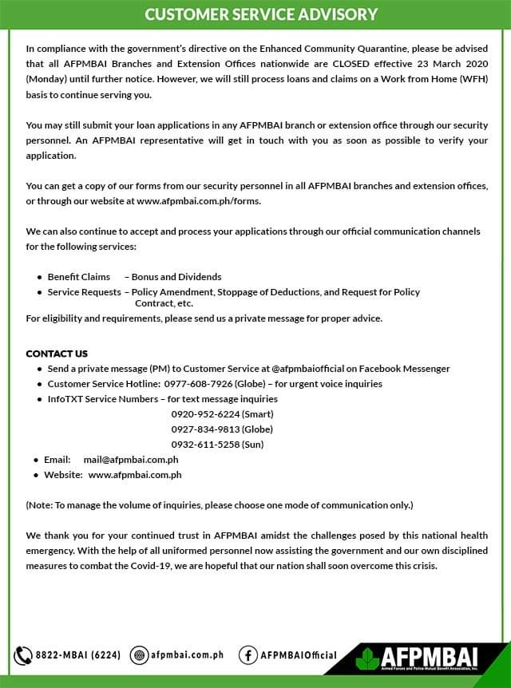
Comprehensive insurance
Opportunity for lifetime financial security
Significant social services
Additional CSR Budget to address the immediate need presented by the pandemic
Notes:
2020 indeed had been a difficult year for AFPMBAI as it challenged its resiliency not only to survive during the crisis but also to sustain its continued operation and relevance. Despite the unraveling effects of COVID 19, AFPMBAI still managed to fulfill its mission of providing members and their families comprehensive insurance, opportunity for lifetime financial security, and as recipients to host of benefits of its significant social services. This was manifested by the innovations AFPMBAI made on the features of its existing products, its grant of loan facilities at low interest rates and the allocation of additional CSR budget to address the immediate medical requirements of the members.

Slide 22



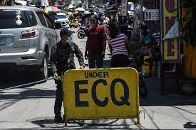

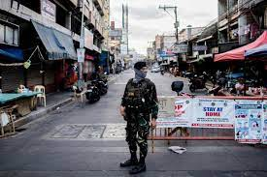
Revenue from
Core Business
5.4%
Revenue Target
for the Year
92%
Notes:
During the times that some companies were removing staff, closing down, or consolidating, the Association opted to remain strong by even increasing its revenue generations from our core business by 5.4%. We achieved 92% of revenue target for the year by implementing strategies and introducing new products relevant to the pandemic. With these, AFPMBAI beams with pride in knowing that it was of service to the members during difficult time that it continued its frontline operations even during the Enhanced Community Quarantine (ECQ) period.

Slide 23
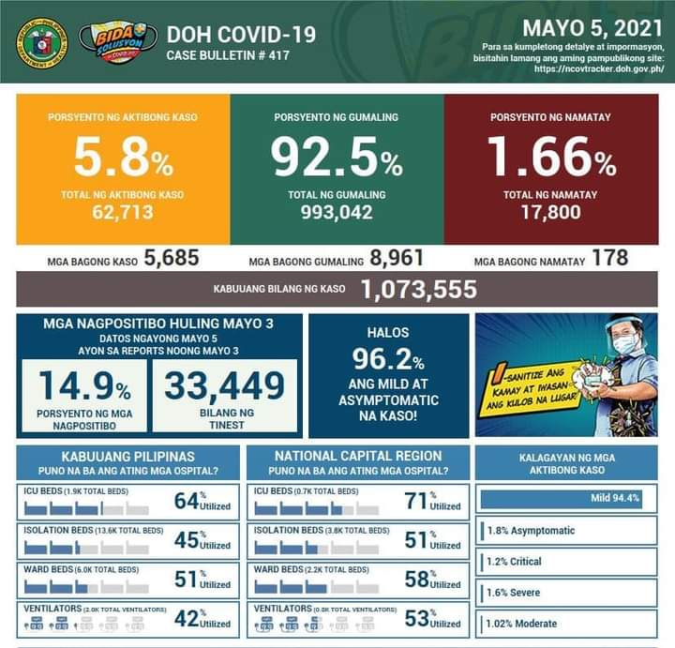




Notes:
There are still challenges for the Association in the coming year given the current development on the pandemic virus. We have geared ourselves to face the unexpected by simulating scenarios of what could still be ahead in this pandemic to continue to sustain our basic delivery of services to our members.

Slide 24
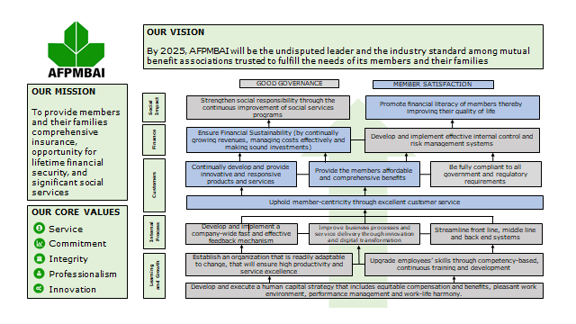

FUTURE PLANS
“struggles always form our greatest strength”
Excellent Customer
Experience and Satisfaction
Notes:
Our approved plans and program for 2021 were crafted and laid out from how we managed our previous year’s challenges especially our experiences during the pandemic year of 2020. As it is always said, “struggles help us become better thinkers and fighters. AFPMBAI had become stronger because of these struggles and better equipped to continue growing in order to provide the best service to our members and their families.

Slide 25

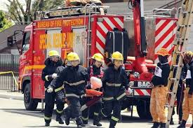



FUTURE PLANS
The undisputed Leader and the industry standard for all mutual benefit associations.
Notes:
We will pursue our vision for AFPMBAI to become the undisputed leader and the industry standard among mutual benefit associations with focus on Good Governance and Member Satisfaction.

Slide 26

Thank You
Members
Board of Trustees
Employees
Notes:
In closing we would like to express our gratitude to all our Members for their faith and patronage, for the unwavering support of the Board of Trustees and the zeal and enthusiasm of all its employees to enable AFPMBAI to pursue its mandate and to bring it to where it is now.

Slide 27
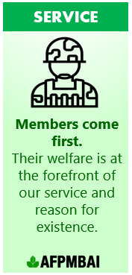

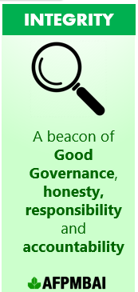

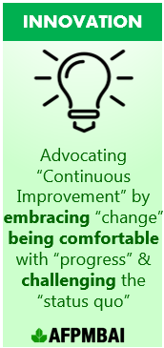
Notes:
We will always strive to become better each day in rendering our services with utmost excellence, guided by our corporate values of service, commitment, integrity, professionalism and innovation.

Slide 28







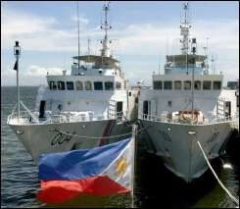







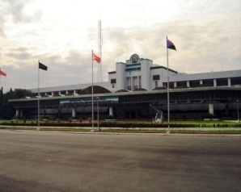
Buhay na Panatag
Notes:
All these, for all our AFPMBAI Members’ “Buhay na Panatag”.

Slide 29

Maraming Salamat
at
Mabuhay Tayong Lahat!
Notes:
Maraming Salamat at Mabuhay Tayong Lahat!

